Slide 1
WIPO Digital Access Service
IP Office Business Solutions

Slide 2
What is DAS?
A service offering a simple and safe digital alternative to filing paper copies of priority documents with multiple patent Offices.
Enables an applicant claiming priority to ask IP Offices of second filing to retrieve a copy of the priority document themselves via the service

Slide 3
DAS – Core Features
Certification – ensure that the correct and unaltered copy of the document is received.
Authorization – applicant must ”furnish” the document to the OSF.
Confidentiality – documents are usually unpublished at the time they must be furnished.
Document Identification – ensure that the correct documents are exchanged.
The DAS service implements these requirements via:
Self-certification of digital libraries by OFF.
Document exchange via SOAP web services over private VPN connections or secure FTP file transfers.
DAS “access code” to authorize access by the OSF.
Standard document formats (e.g. PDF) and metadata.

Slide 4








How DAS works
A service offering a simple and safe digital alternative to filing paper copies of priority documents with multiple Offices.
Traditional Paper Exchange
DAS Digital Exchange
Office of first filing
(1)
(1)
Office of first filing
(2)
(3)
(2)
(1.a)
(1.b)
DAS
(2.a)
File an IP application
Request multiple
certified copies
(3) File a subsequent
application to each Office of second filing and furnish a certified copy separately
(1) File an IP application and
request to use it in DAS
(a) Register the certified copy
(b) Issue the access code
(2) File a subsequent application
to each IP Office with the
priority document details and the
access code
(a) Retrieve the certified copy from
DAS with the access code
Offices of second filing
Offices of second filing

Slide 5
Changes for Applicants
When requesting a certified copy of application to the office of first filing, applicant will receive a DAS access code instead of the certified copy on paper
Applicant should provide the DAS access code along with the priority claim details without the need to furnishing a certified copy on paper in subsequent filing with an office of second filing
A secure portal is made available as an optional tool for applicants to track exchange of priority documents by offices only. The actual priority document contents cannot be downloaded with this tool

Slide 6
Office Implementation
As Office of First Filing (OFF)
  Administrative change in the national filing procedures to record the request to use DAS (access code generation is optional)
  IT change to implement the DAS registration via Trilateral Document Access for IP5 / ID5 Offices only, via PCT Electronic Data Interchange Service (PCT-EDI) or manual process by using a secure Office Portal for other Offices
As Office of Second Filing (OSF)
  Administrative change in the national filing procedures to allow the applicant to supply the access code for DAS retrieval
  IT change to Implement the DAS retrieval registration via Trilateral Document Access for IP5 / ID5 Offices only, via PCT-EDI or manual process by using a secure Office Portal for other Offices
Voluntary participation as OFF only, as OSF only
or in both capacities
Office’s decision to offer the service free of charge or not

Slide 7
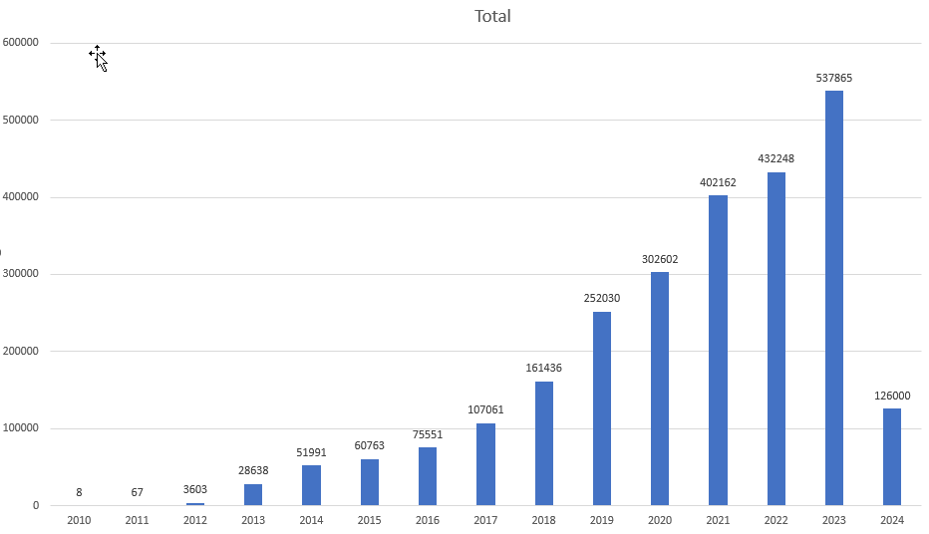
Current Status

Slide 8
Planned Changes in 2024
New Secure REST Web Services (faster and high-volume data exchange with limitation of file sizes)
  Registration of certified copies by offices of first filing
  Retrieval of certified copies by offices of second filing
  Retrieval of document exchange statistics
  More info: https://www3.wipo.int/confluence/display/dascg/New+DAS+exchange+API
Cloud Hosting of DAS Infrastructure for document exchange and distribution only (stability, highly secure, high availability, scalability, cost-effective)
  Prod est. for May, 20th 2024

