Slide 1
Moving towards accepting vector files
Early 2023: exploration and engagement with Offices and users started
  Update to the image file specifications to allow better quality reproductions - Hague Electronic Communication - WIPO Wiki
Draft technical requirements have been proposed to stimulate discussions

Slide 2
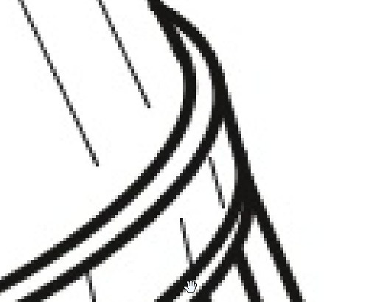

Low-hanging fruit: increasing resolution
Baseline (JPG 300 dpi)
Improved resolution (600 dpi)

Slide 3

A better raster format for line drawings: PNG
Baseline (JPG 300 dpi)
PNG (600 dpi)

Slide 4

The best format for line drawings: Vector
Baseline (JPG 300 dpi)
Vector (SVG)

Slide 5
Main challenge and risk
Import
Office A System
Copy of images
International Bureau system
International Design Bulletin
Import
Office B System
Images
Images
Copy of images
Import
Office C System
Copy of images

