Slide 1

Towards a Regional IP
Register for Africa
Importance, Benefits and Lessons
from the ASEAN IP Register
WIPO · IPOBSD
Africa IP Register Coordinators Meeting
Dr. Juneho Jang | Head, Global Relationship Management | WIPO
2025

Slide 2
Presentation Overview
Six themes — from ASEAN experience to Africa's opportunity
01
The Case for a Regional IP Register
04
Data Commercialization & AI Services
Why regional collaboration on IP data creates systemic advantages
Global AI Access Group, commercial partnerships, revenue pathways
02
ASEAN IP Register: Origins & Architecture
05
Key Lessons & Critical Success Factors
From August 2023 to 8.3 million+ records across 10 member states
What worked, what surprised us, and what Africa must plan for
03
Data Sharing Framework & Governance
06
The Africa IP Register Vision
Trust models, data standards, and bilateral cooperation mechanisms
Roadmap, ARIPO partnership, and next steps for the region

Slide 3
The Case for a Regional IP Register
Fragmented national data cannot serve a connected regional economy
THE FRAGMENTATION CHALLENGE
THE REGIONAL REGISTER OPPORTUNITY
54 African IP offices operating in data silos
No single source of regional search — investors face 54 separate searches
Patent thickets deter cross-border R&D and technology transfer
Duplicate processing costs across national offices
AI and data analytics locked out of regional market due to fragmentation
Africa's share of global patent activity disproportionately low vs. economic size
Single authoritative source for all regional IP data
Easier access and timely searching
Enable regional patent analytics for governments and investors
Unlock commercial data licensing revenues for member offices
Position African IP offices as AI data partners globally
Support AfCFTA implementation with IP data infrastructure

Slide 4
ASEAN IP Register: Origins & Architecture
Launched August 2023 — from mandate to 9 million+ records in under 18 months
2019–22
Aug 2023
2023–24
2024
2025+
ASEAN Digital
Transformation
Task Force Mandate
ASEAN IP Register
Official Launch
(WIPO–AEM)
10 Member States
Onboarded; Data
Standardization
AI Partnership
Negotiations Begin;
Global AI Access Group
Commercial Licensing;
Africa & Asia-Pacific
Replication
9M+
10
4
<18
IP Records
Aggregated
ASEAN Member
States Connected
Commercial AI
Partners Engaged
Months from
Launch to Scale
ASEAN IP Register covers: patents, utility models, trademarks, industrial designs and geographical indications — searchable IP databases and national office interfaces. Operational under ASEAN Digital Transformation Task Force with WIPO technical leadership.

Slide 5

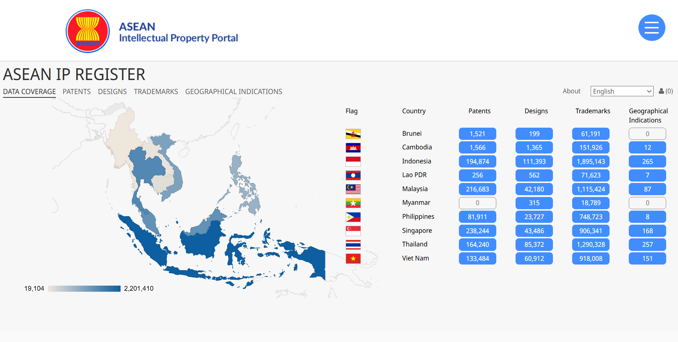


ASEAN IP Register
https://www.aseanip.org/services/ip-register
Patents and Utility Models:
1,032,779
Industrial Designs:
369,511
Trademarks:
7,177,496
Geographical Indications:
955
Total:
8,580,741
Notes:
ASEAN patent filings exceed 1 million—a historic milestone for regional innovation

Slide 6
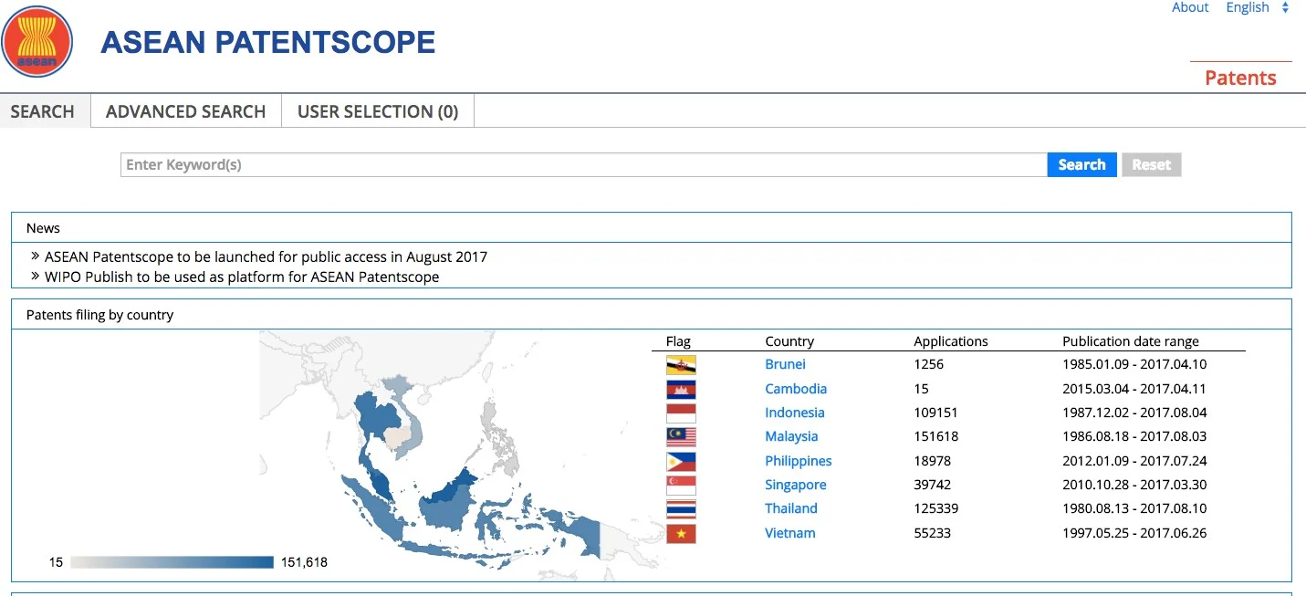
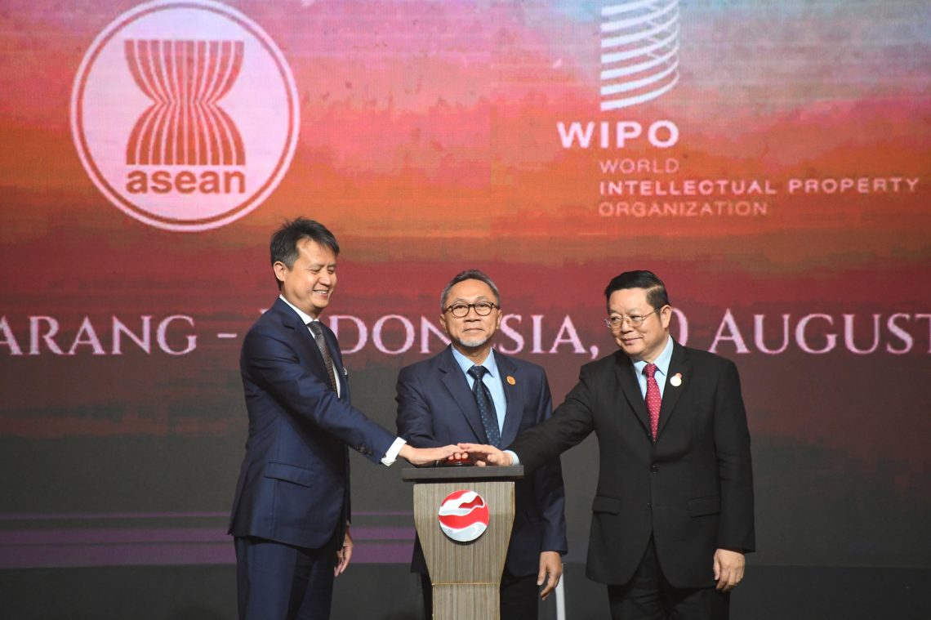
Brief History
ASEAN PATENTSCOPE
  August 29, 2017
  Hosted by DGIP, Indonesia
  Over 5,000 patents (https://www.aseanip.org/home/2023/03/03/public-rollout-of-asean-patentscope-service)
ASEAN IP Register
  August 20, 2023
  https://asean.org/asean-intellectual-property-register-to-officially-launch/
ASEAN IP Register – GI Data Integration
  August 11, 2025

Slide 7



Data Sharing Framework & Governance
Trust architecture that enabled 10 sovereign offices to contribute to a single register
Legal & Policy Layer
Technical Standards Layer
Governance & Operations Layer
ASEAN Memoranda of Understanding on IP data exchange
Data sovereignty preserved — national offices retain ownership
Bilateral data sharing agreements per office pair
WIPO as neutral data custodian and platform host
WIPO IPAS data schema as baseline for harmonization
ST.96 XML standard for structured IP data exchange
API-based real-time and batch data submission pipelines
Deduplication and data quality scoring framework
Multi-language metadata normalization (7 languages)
ASEAN IP Digital Transformation Task force
WIPO IPOBSD as Technical Partner
Regular data audit and quality assurance cycle
Staged onboarding: pilot → national → full contribution
Capacity building embedded in all implementation phases
Key insight: WIPO's role as a trusted neutral party was foundational. No single national office hosted or controlled the register — this neutrality was essential for political buy-in.

Slide 8
Data Commercialization & the Global AI Access Group
What is the Global AI Access Group?
01
AI-Powered Prior Art Search
IP offices gain instant AI search powered by the regional dataset, reducing examination backlogs.
02
Patent Analytics for SMEs
Commercialized analytics services delivered to local innovators via national office portals.
WIPO's Global AI Access Group is a structured partnership framework through which leading AI service providers — including Clarivate, PatSnap, Questel, and WIPS — obtain licensed, structured access to regional IP data.
Business Model: IP Office gain free AI services or possibly revenue can be generated opening the window of collaboration.
Value Exchange: AI partners gain high-quality training data; IP offices gain analytics tools without infrastructure investment.
03
Training Data Licensing
Structured IP data licensed to global AI firms as premium training datasets.
04
Bulk data licencing
Annual licenses for full dataset downloads to AI/analytics firms
WIPO | Africa IP Register Meeting

Slide 9


Data Commercialization & the Global AI Access Group
Data Commercialization & the Global AI Access Group
Turning regional IP data into sustainable value for national offices and the innovation ecosystem
GLOBAL AI ACCESS GROUP
COMMERCIALIZATION MODELS
Consortium of leading AI service providers seeking structured, regionally-aggregated IP data
Includes Clarivate, PatSnap, Questel, WIPS and emerging AI analytics platforms
AI training datasets require breadth + depth only a regional register can provide
National offices individually cannot meet AI data appetite — regional pooling is essential
ASEAN IP Register positioned ASEAN offices as a unified AI data partner
Revenue can be distributed back to contributing national offices proportionally
Bulk Data Licensing
Annual licenses for full dataset downloads to AI/analytics firms
API Access Tiers
Freemium for researchers; paid tiers for commercial applications
Premium Analytics
Pre-built analytics products (tech mapping, landscape reports)
Custom Data Feeds
Tailored data pipelines for specific AI training requirements
.

Slide 10






AI Services for National IP Office Operations
Regional data enables AI tools that transform examination quality and efficiency at every member office
Prior Art Search
Technology Landscaping
AI-powered search across global IP records reduces examiner search time from days to hours. Examiner accuracy improves dramatically with regional data coverage.
Automated technology trend reports for government agencies and R&D institutions. Supports national innovation policy with real-time data.
IP Portfolio Analytics
Automated Classification
Track ownership concentration, cross-border filing patterns, and technology transfer flows across the region using unified data.
AI classification (IPC/CPC) trained on regional data delivers higher accuracy than models trained on global data alone, especially for local technology domains.
Office Automation
Innovation Intelligence
Document processing, form validation, correspondence drafting — all powered by AI models fine-tuned on authentic regional IP data from the register.
National offices can offer innovation intelligence services to enterprises and universities — new revenue stream built directly on the regional register.

Slide 11
Key Lessons & Critical Success Factors
3 years of ASEAN experience distilled into actionable guidance for Africa
Political Will Must Precede Technology
Start With What You Have
01
The ASEAN IP register succeeded because senior leadership at each national office committed before a single line of code was written. Technology follows mandate.
02
Early ASEAN data was imperfect. Waiting for clean data means never starting. Build quality improvement into the ongoing process — do not let perfect be the enemy of operational.
WIPO Neutrality is a Strategic Asset
Commercialization Requires Advance Governance
03
No member state wanted another member state to control the register. WIPO as host removed this barrier entirely. This structural choice was decisive.
04
AI partner negotiations exposed gaps in data ownership agreements. Africa must establish cooperation agreement with WIPO for data sharing with commercial partners.
Capacity Building Cannot Be an Afterthought
AI Partnerships Demand Continuous Governance
05
Offices with weaker technical capacity contributed lower-quality data. ASEAN learned to embed capacity building from day one, not as a remedial measure.
06
Commercial AI partners seek continuous data feeds, not one-time exports. Africa needs standing operational capacity to manage these partnerships over time.

Slide 12
The Africa IP Register: Vision & Roadmap
Building on ASEAN foundations — adapted for Africa's unique context and ambitions
OUR VISION
Governance framework & MOU drafting
1st pilot: 3 countries
WIPO IPAS data standards alignment
Stakeholder capacity assessment
A unified, authoritative Africa IP Register connecting all African IP offices — enabling regional innovation, powering AI services, and creating easier public access for national IP data across the continent.
PHASE 1 · 2025–2026
Africa IP register : one-stop African IP data portal
WIPO IPOBSD as technical platform and data standards partner
African continental integration aligned with many policy objectives
Phased approach: pilot offices → ARIPO, OAPI bridge → all 54 offices
Africa as lead contributor to Global AI Access Group from 2026
Full ARIPO member onboarding (20 offices)
Public portal launch (Beta)
First commercial AI partnership pilot
Data-sharing framework activated
PHASE 2 · 2026–2027
Continental scale: 54 African offices
Full Global AI Access Group integration
Africa IP analytics products launched
Self-sustaining commercial revenue model
PHASE 3 · 2027+

Slide 13

The Time to Act is Now
Africa's Regional IP Register — Key Takeaways
ASEAN proved in 18 months that a regional register is technically and politically achievable
Data sharing at scale is possible when governance, standards, and trust architecture are right
Data commercialization creates the opportunity for Africa to access AI services and makes the register sustainable
WIPO IPOBSD stands ready to deploy the same platform, standards, and expertise for Africa
The Global AI Access Group is actively seeking African IP data — this is a time-sensitive window
Dr. Juneho Jang
Head, Global Relationship
Management Section
WIPO · IPOBSD
juneho.jang@wipo.int
World Intellectual Property
Organization (WIPO)
Geneva, Switzerland
CALL TO ACTION
Building Africa's IP
Data Future — Together
Endorse the establishment of a WIPO–Africa Technical Working Group on the Africa IP Register. Commit to a 6-month feasibility study and pilot governance framework with WIPO IPOBSD support. Begin the journey that ASEAN started in 2023.

Slide 14
Thank you!
2024

