Slide 1


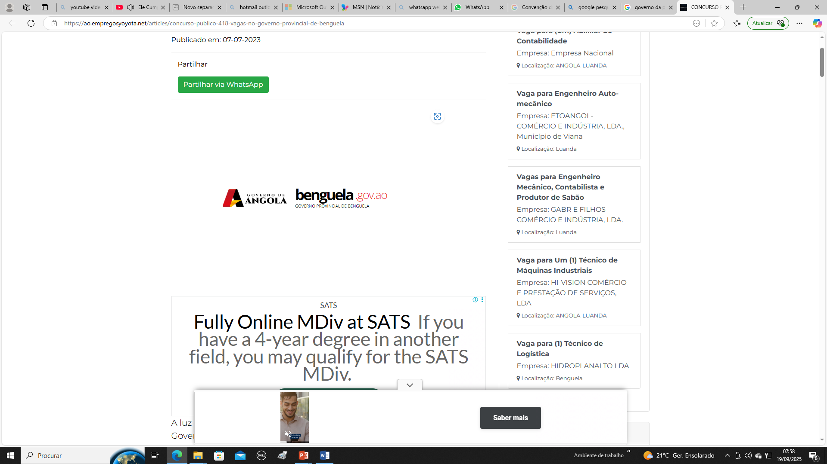

REPÚBLIC OF ANGOLA
MINISTERY OF INDUSTRY AND COMMERCE
ANGOLAN INSTITUTE OF INDUSTRIAL PROPERTY

Slide 2
Data Quality Challenges and Solutions at IAPI
Microsoft Access & IPAS
Data migration from Microsoft Access to IPAS improved overall data quality
Cândido Duarte & Isaura Sousa

Slide 3
INTRODUCTION
We highly value statistical data because it serves as a guiding compass, allowing us to pay closer attention to aspects we sometimes overlook, such as which provinces or countries need more attention, the volume of incoming applications, the number of applications processed, the backlog in processing applications, among others

Slide 4

INCOMPLETE OR INCONSISTENT DATA
Trademark, patent, and industrial design records
Missing or conflicting information
Affects reliability and data usability

Slide 5
Digitization of Legacy Records
Conversion from physical to digital format
Risk of data loss or errors during migration
Lack of Standardization
Variations in data entry (names, dates, classifications)
Difficulties in data analysis and comparison
Human Errors •
Manual data entry issues
Duplications and inconsistencies
System Integration Challenges
Difficulty connecting different platforms
Fragmented databases
Data Updating Issues
Outdated information on applicants, status, or payments
Reduced accuracy and trust

Slide 6
Automated Systems
Implementation of digital platforms Automatic data validation
Standardization of Procedures
Clear guidelines for data entry and management
Consistency across systems
Staff Capacity Building
Continuous training in data management
Improving accuracy and efficiency

Slide 7
Conclusion
Data quality is essential for effective IP management
Continuous improvement is key to institutional success

