Slide 1

BOTSWANA-WIPO MODEL OFFICE
AFRICA IP REGISTER COORDINATION MEETING, APRIL 20-24, 2026
Maputo, MOZAMBIQUE
DATA QUALITY CHALLENGES AND SOLUTIONS
Presentation by:
Ms Keletso Linchwe and Ms Basadi Badirwang

Slide 2
INTRODUCTION
Mandate of CIPA IP Office (Botswana): To administer the Industrial Property Act [CAP.68:03], which legally protects patents, trademarks, utility models, and industrial designs. The scope was expanded in 2010 to include Geographical Indications, Trade Secrets, and Traditional Knowledge.

Slide 3
BACKGROUND
The automation of Botswana’s IP business processes started in 2004. The World Intellectual Property Organization (WIPO) Provided the Industrial Property Automation System (IPAS) software and equipment to support the deployment. The Project started with the capturing of all trademarks into the database. Patents were later captured into the IPAS in 2008.
In August 2012, IPAS was upgraded to the latest Java Version (From IPAS Centura). With all upgrades, the system offered more functionality and was more user friendly. IPAS has since been upgraded to better and improved versions almost every year since then. IPAS has come from version 2.4, 2.7, 3.1, 3.3, 3.4, 3.5, 3.6 sf now IPAS 4 (Cloud Version).
The Electronic Document Management System (EDMS) was deployed in May 2014 to support digitization of paper documents of the front files.

Slide 4
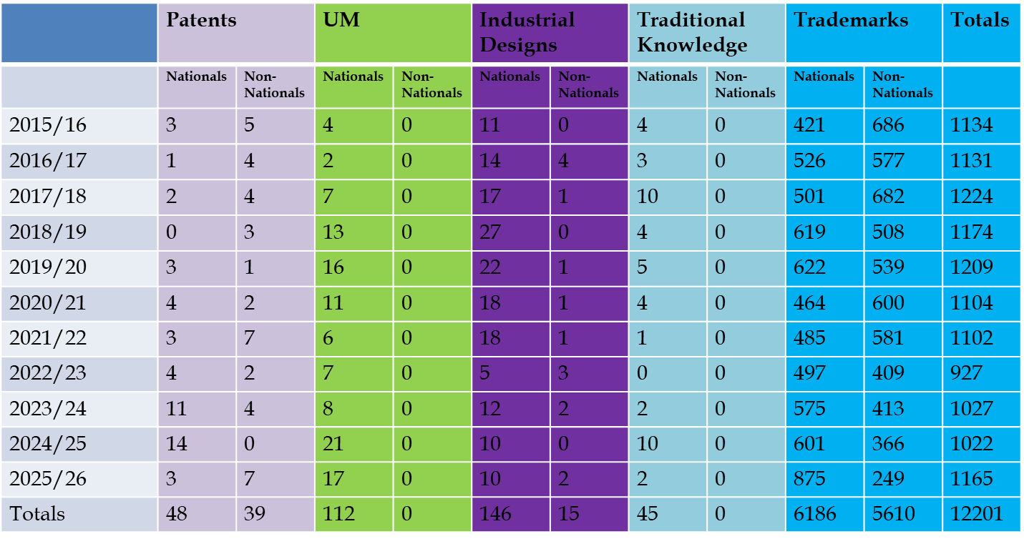
IP REGISTRATIONS

Slide 5
SUCESSFUL PROJECTS
The WIPO Model office project is thus far at 86% done with the following modules/systems already deployed;
Data Validation & Verification Project
Digitization Project
IPAS Upgrade ( from IPAS 3.6 to IPAS 4 Cloud including WIPO File deployed to agents only)
Madrid Module
ARIPO MS Module
WIPO Publish (Currently On CIPA Website)

Slide 6
AUTOMATION OF IP PROCESSES IN BOTSWANA- Data Capturing Challenges
Temporary staff who were challenged with understanding the IP Jargon were employed. Quality Checks were done, however CIPA still had the following challenges:
There were still some figurative marks that were not captured into the system (Missing Logos)
Missing Physical Files
Data not Clean, e.g sequencing, wrong expiration dates, Application Types, Series, numbers e.t,c not correctly captured as according to their IP area. Some Madrid had MD as while some had D, while some ARIPO files had BW which is a local identifier instead of AP and some Trademarks had T as a subtype identifier instead of M
Some Daily logs not closed
Madrid duplications
Some workflow actions leading to wrong status nor following the correct order

Slide 7
AUTOMATION OF IP PROCESSES IN BOTSWANA- Data Capturing Challenges….continued
IPAS Madrid Module frequently faced problems in loading “Birth” Madrid transactions due to:
Missing/Invalid Vienna Codes and/or
Missing/Invalid Nice Codes
Missing/Invalid Country Codes

Slide 8
SOLUTION TO DATA CHALLENGES
IP Officers did data validation again before commencing the digitization project
Formalities Checked before Filling receipts and also a re-check at Substantive Examination, therefore continous validation
Performed Data Sanity Checks which came with resolution scripts, e.g Madrid duplications corrected in the Database, Numbering Sequence corrected
Importing of relevant Nice, Vienna and Lorcano Classifocations
Re working on the configuration files to correct issues of country codes and re-importing them
Process Re-engineering to correct workflows and statuses

Slide 9
TRANSITION FROM IPAS 3 to 4- DATA RELATED CHALLENGES AND SOLUTIONS
Technical Challenges:
Critical Challenge of Data Migration:
  Problem: Moving a massive amount of unstructured, critical data from IPAS 3 ("data silos") to conform to the new unified data model of IPAS 4.
  Key Risk: Maintaining absolute data integrity and mitigating the high risk of corruption or loss.
  Inconsistencies: A key challenge was indexed backfiles between 2021 and 2023 being non-existent in the system.
Integration Necessity: Ensuring IPAS 4 smoothly integrates with external, non-IP systems (e.g., local bank Payment Gateways).
  Issue: The new reconciliation reports are too complex, threatening workflow and the accuracy of financial data. A thorough, system-wide review is needed.

Slide 10
TRANSITION FROM IPAS 3 to 4- DATA RELATED CHALLENGES AND SOLUTIONS continued…..
Operational Transformation and E-Filing
Shift to Electronic Workflows: IPAS 4 provides end-to-end automation, dramatically increasing efficiency through the deployment of electronic work assignments compared to the former paper-intensive handling. Reduced Office Human Errors of Data Capturing as some physical forms may be unreadable

Slide 11
TRANSITION FROM IPAS 3 to 4- DATA RELATED CHALLENGES AND SOLUTIONS continued…..
Operational Area | Identified Functional Issue (Example) | Resolution Status/Action Taken
Template Management | UM receipt lacked action user signature; | Customized template logic revised; field mapping corrected .
Correspondence Variables | Templates like Withdrawal, Extension of time failed to pick written content or relevant dates. | Re-configuration of associated workflow actions.
Workflow Actions | Need for action creation allowing revision of Patents and UM processing actions. | Re-Configuration of workflows done
Financial Reconciliation | Extract pending invoices that have not been validated by Finance. | Proposal to extract a csv file on daily basis to finance.

Slide 12
TRANSITION FROM IPAS 3 to 4- DATA RELATED CHALLENGES AND SOLUTIONS continued…..
Financial Reconciliation Gap: The IPAS internal payment report lack crucial fields needed to match it against the external Payment Gateway settlement report, preventing daily revenue reconciliation.
Required Resolution: Modify the IPAS system's reporting function to include the missing fields for a comprehensive exportable report.
CIPA is currently working with WIPO to address the above

Slide 13
THANK YOU

