Slide 1
Automation and Data Quality Management
Ghana IP Office
Samuel Ohene-kankam
Teddy Edu-Yaw
Godsentina Gogo-Tawiah

Slide 2
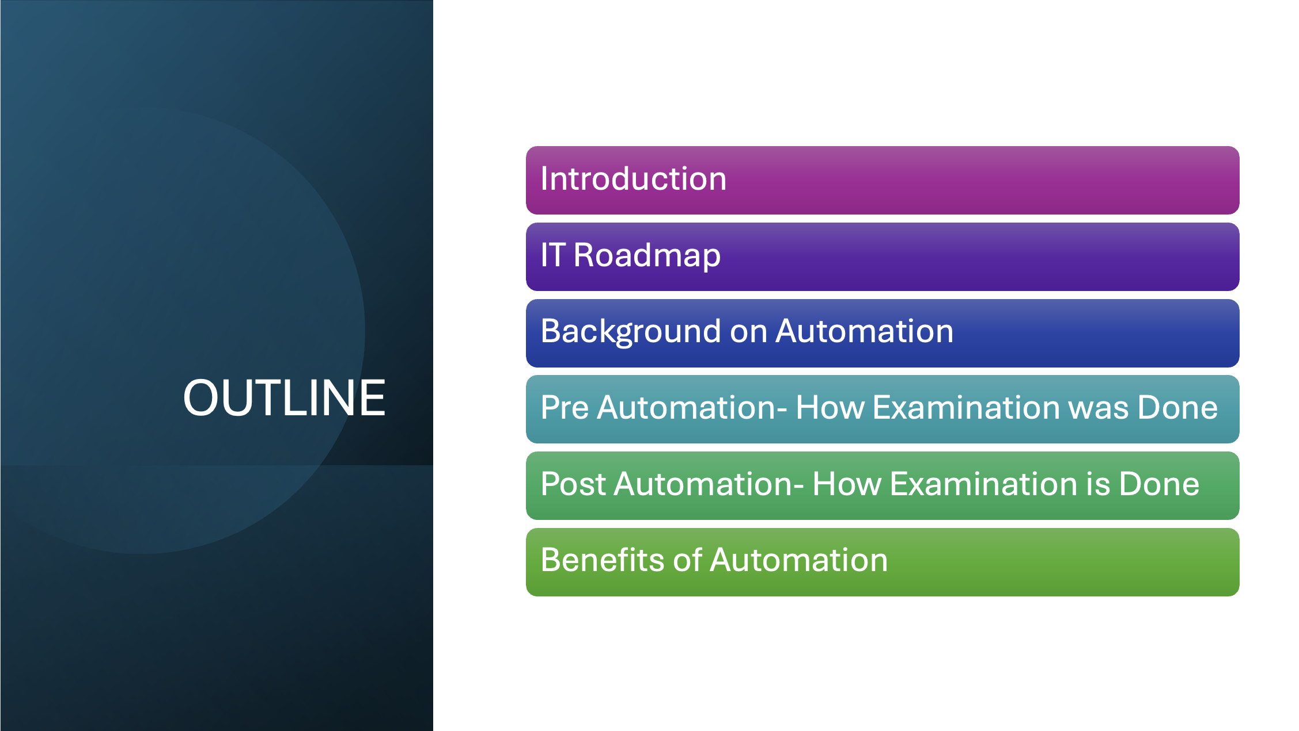

Slide 3





Office of the Attorney-General & Ministry of Justice
Registrar-General’s Department
REGISTER ORDINANCE MARRIAGES
Keep the register of all marriages in Ghana
Christian and other marriages
Cap127
Industrial
Property
Rights
Administration
of
Estates
Administering estate of deceased
Payment of commuted pension
Death gratuity
Trust administration
Trademark
Patent
Industrial Design
Plant Variety Protection
Geographical Indication

Slide 4
Legal Framework
Plant Variety Protection Act 2020 (Act 1050)
Geographical Indications Act, 2003 (Act 659)
Industrial Designs Act, 2003 (Act 660) and Industrial Designs Amendment Act, 2020 (Act 1033)
Patent Act, 2003 (Act 657) and Patents (amendment)Act, 2020 Act 1060)
Trademarks Act, 2004 (Act 664) and Trademarks(amendment) Act, 2014 (Act 876)

Slide 5
Introduction
Ghana IP Office has transitioned to semi-automation.
Manual filing persists, but data quality has improved.
Africa IP Register presents opportunity for full transformation.

Slide 6
IT Road Map
GHIPO recognises ICT as one of the key drivers for the successful delivery of its mandate
Use the following five (5) guiding principles
  Creating a business-led technology road map
  Developing and upskilling talent
  Shifting to a modern technology environment
  Focusing on data management and enrichment
  Driving the adoption and scaling of digital initiatives

Slide 7
Pre- Automation
Prior to IPAS the office receive trademark application record them in a register and giving them Application numbers manually.
Trademark examination is done manually
After final approval by the legal unit a registration number is assigned to the mark .
The applications are then compiled and submitted to the national publishing corporation.
Certificate is issued on expiry of the opposition period.

Slide 8
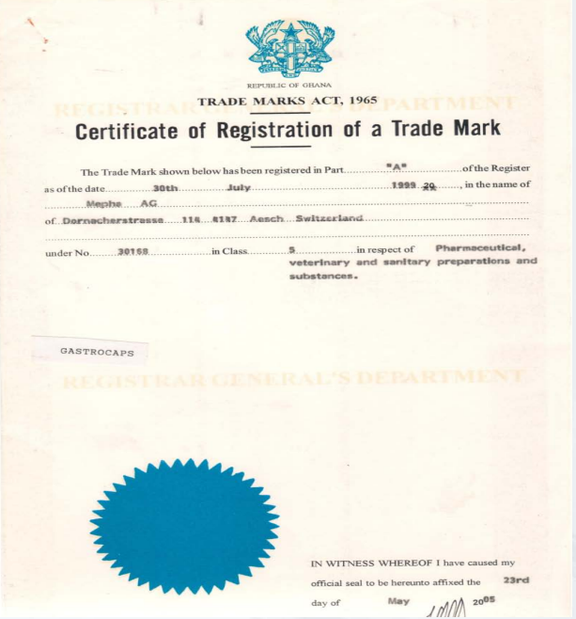
Manual Certificate

Slide 9
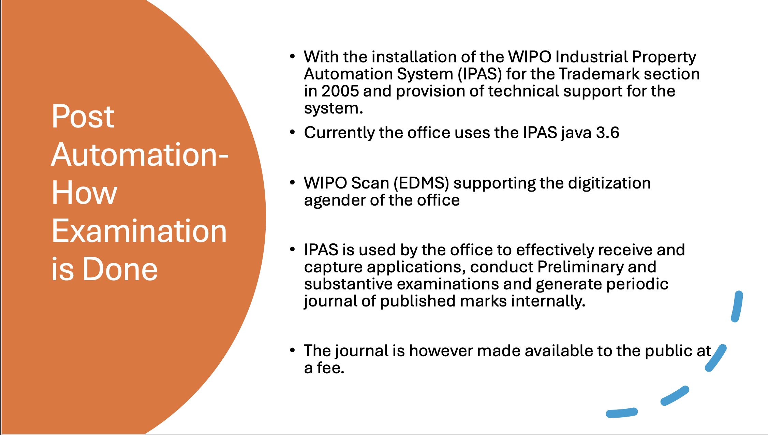

Slide 10
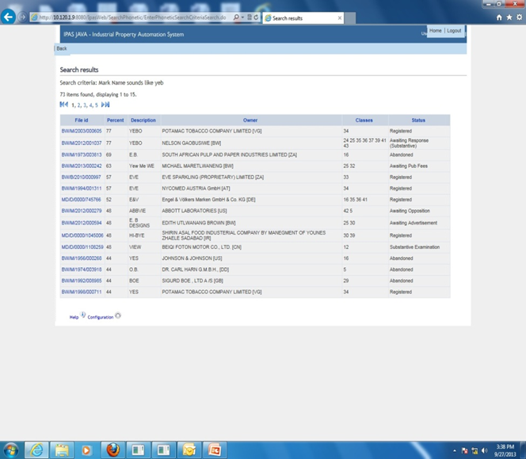
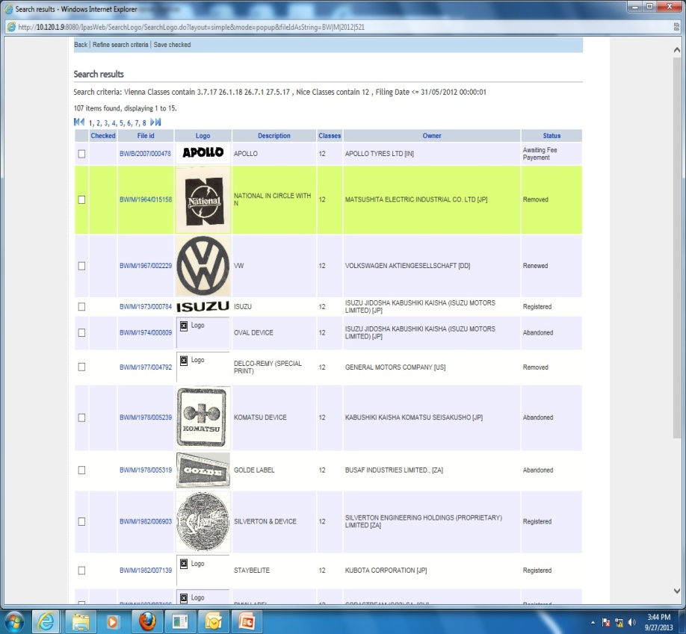
Post Automation

Slide 11
Benefits of Automation
Pre-filing Search for word marks
Trademarks examinations are done faster.
We are able to publish the trademarks journal faster.
Easy preparation of statistical data and report.
Efficient management of employee productivity
Increase number of filings .
Increase in revenue

Slide 12
Current filing system
• Fully manual filing
• Physical documentation required
• Post-filing digitization – using IPAS, wipo scan

Slide 13
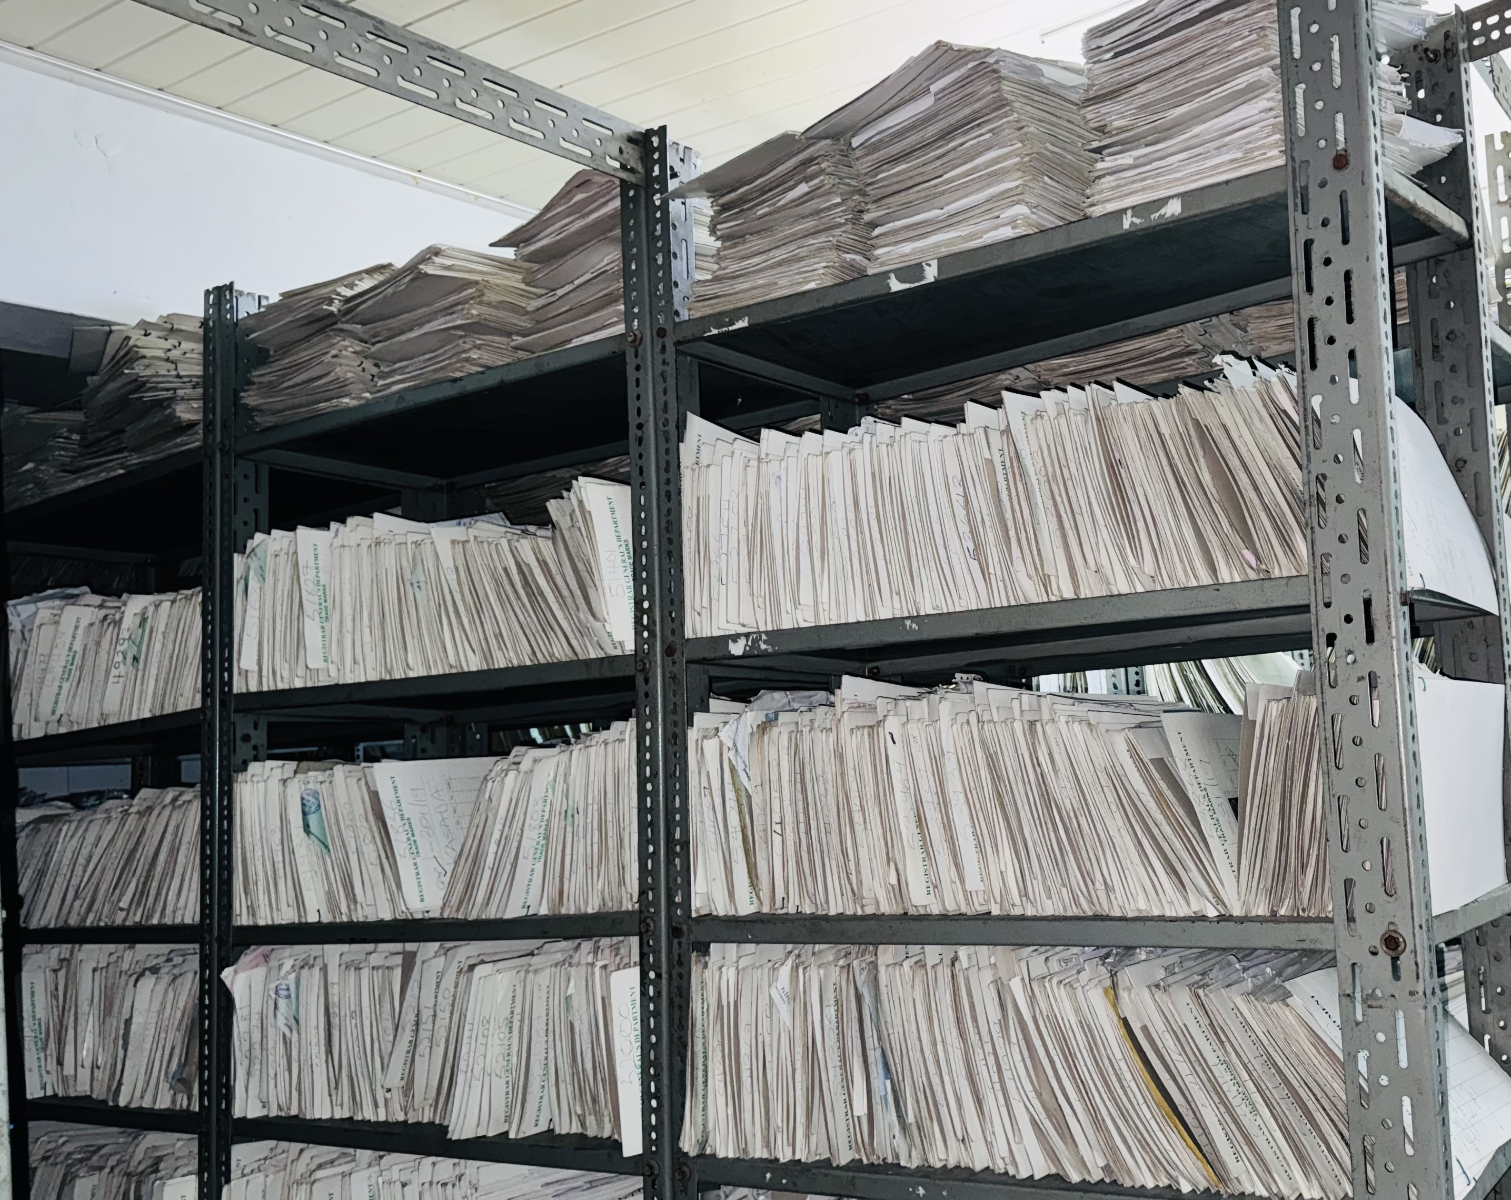
Physical Files

Slide 14
Validation framework
• Validation before substantive examination
• Validation before publication
• Reduces downstream errors

Slide 15
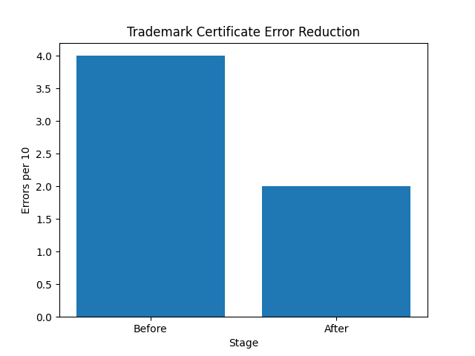
Data Quality Improvement

Slide 16
Data Quality Insights
• Errors reduced by 50%
• Double validation system effective
• Residual inconsistencies remain

Slide 17
Future Plans
Capturing all applications into IPAS and process them.
On-line filing of IP application to improve accessibility .
Providing for on-line payment systems

Slide 18
Conclusion
Automation has brought a great improvement in service delivery and can still be leveraged to increase customer satisfaction.

Slide 19
Thank You

