Slide 1
Interoperability with Member States Systems
WIPO Suite Products and Services
April 22, 2026
Gregory Sadyalunda
WIPO Industrial Property Business Solutions Division (IPOBSD)
Notes:
1

Slide 2

Agenda
  Before IPO Digital Transformation
  WIPO Solutions – Products and Services
  IP Office Digital Transformation
  What is IPAS?
  What is WIPO File?
  What is WIPO Publish?
  What is IPAS Madrid Module?
  What is ARIPO Member States Module?
Notes:
2

Slide 3
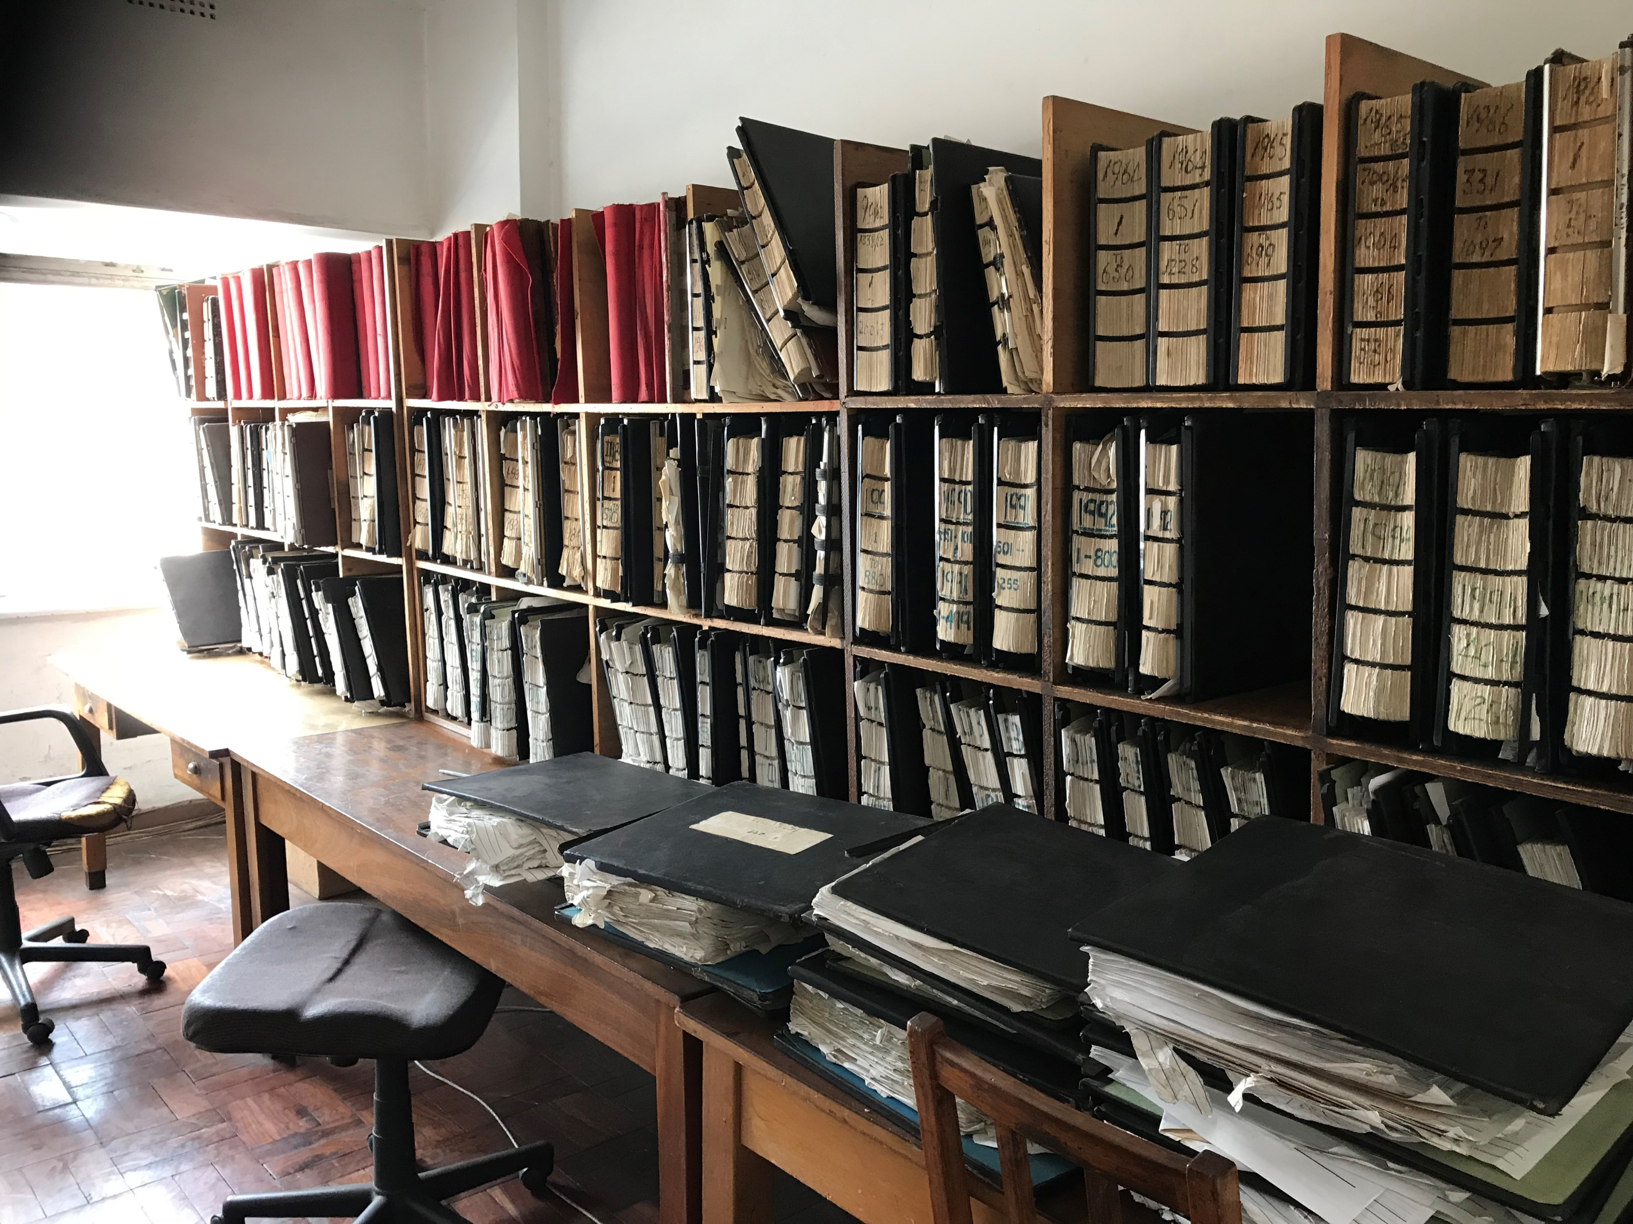
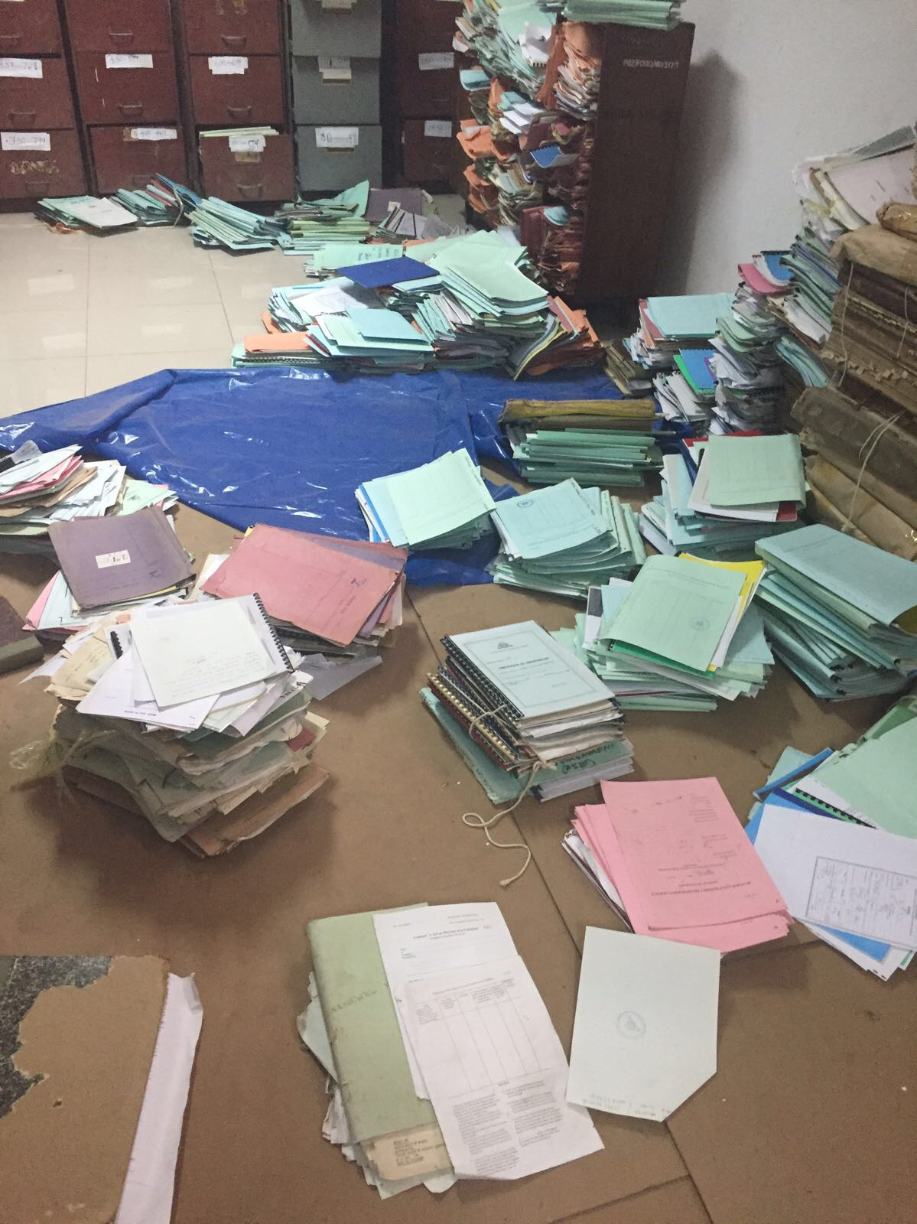
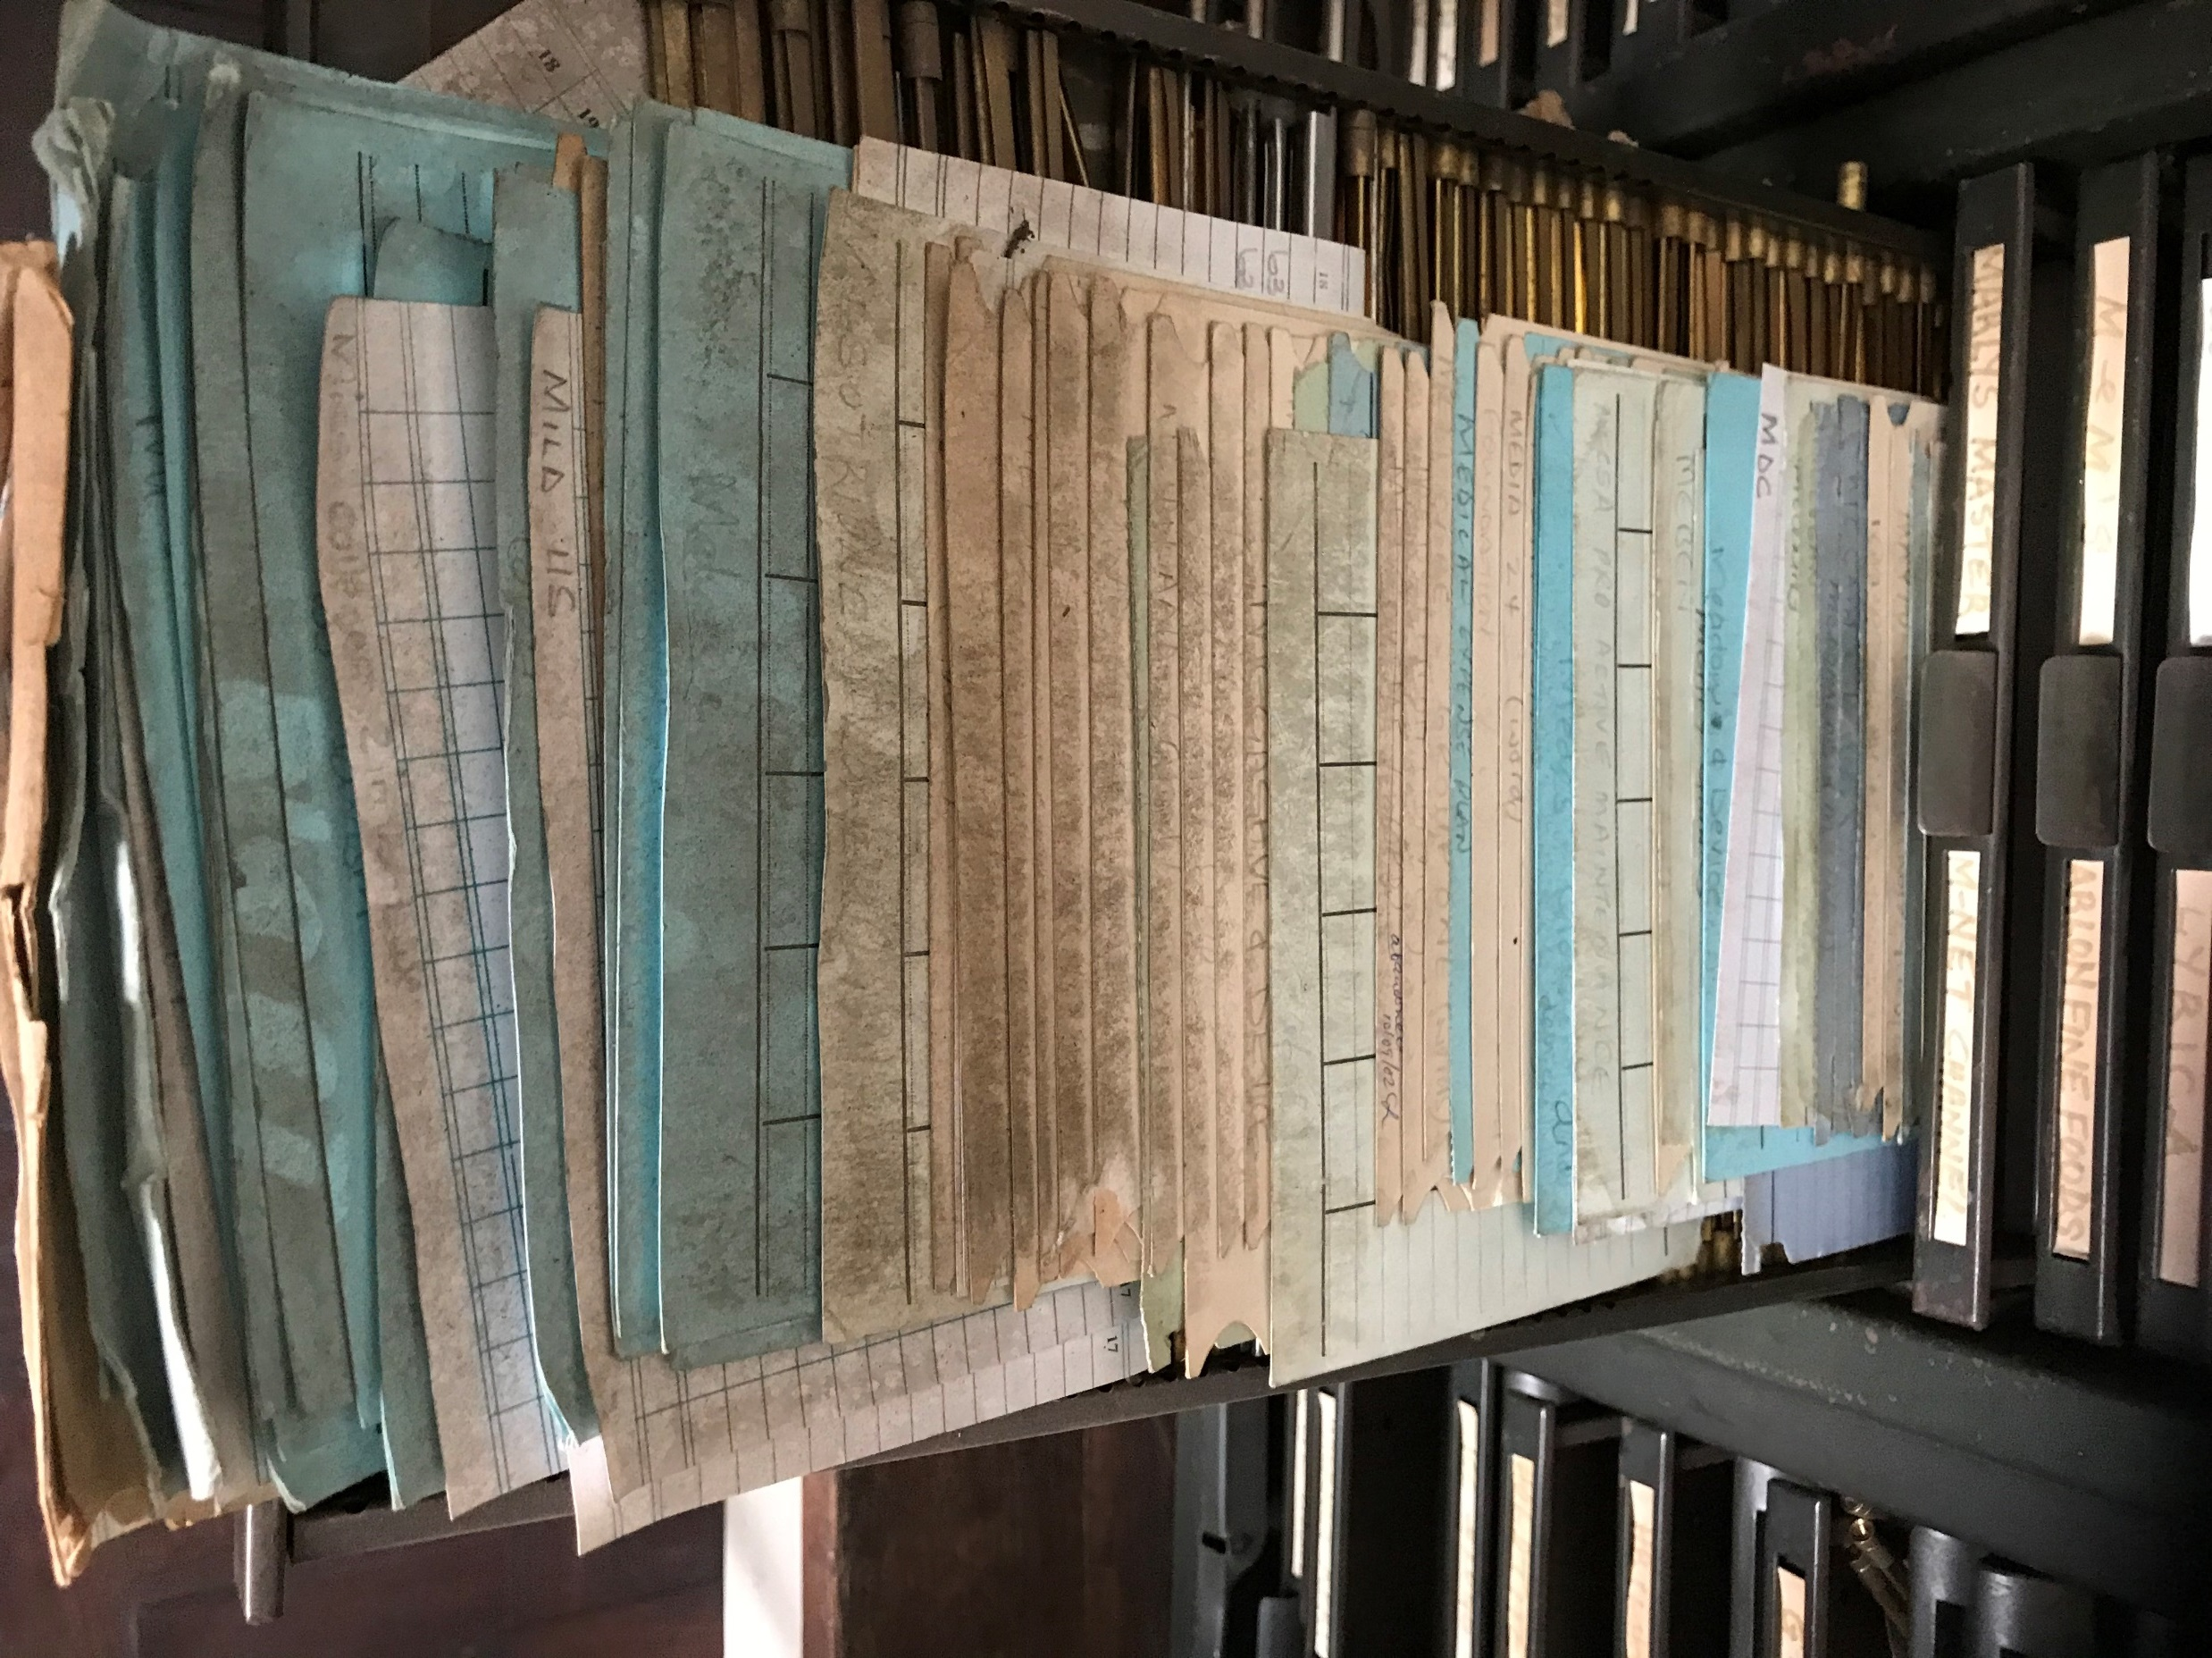
IP Office – Before Digital Transformation

Slide 4
4
General IP Office Core Functions
Filing/Reception
Administration
Publication & Dissemination of Info.
Archive & File Management
Examination
Registration

Slide 5
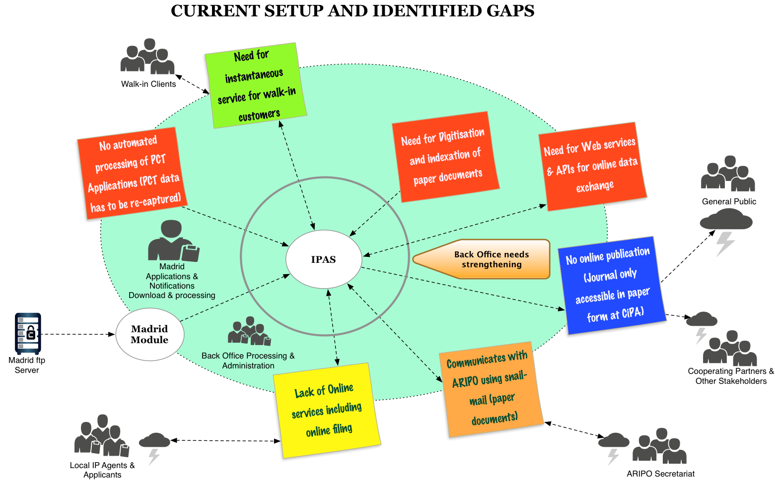
Example Needs Expressed by an IP Office

Slide 6
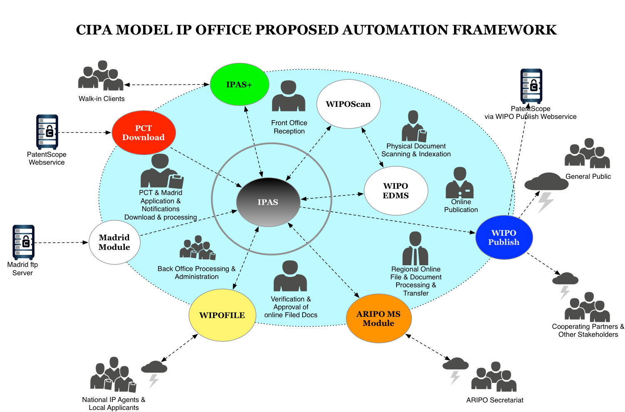
WIPO Solutions – Products and Services

Slide 7
7
Support for IP Office Business Processes
Filing/Reception
IPAS Reception Module
Administration
IPAS Core System
Publication & Dissemination of Info.
IPAS Journal Management Module
Data Exchange with PatentScope, Global Brand Database
WIPO File
Electronic Document Reception
WIPO Publish
Archive & File Management
IPAS dossier tracking
Examination
IPAS Support for TM Examination
Integration with Global IP Systems
Madrid Module
WIPO Scan
WIPO EDMS
More Support for Patent Examination
WIPO CASE Integration
PCT Integration
WIPO Publish EDMS

Slide 8
From Manual to Electronic Processing
Archives
Data Capture
03
Certificates
Dossier
IPAS
Digitization
Journal / Letters

Slide 9
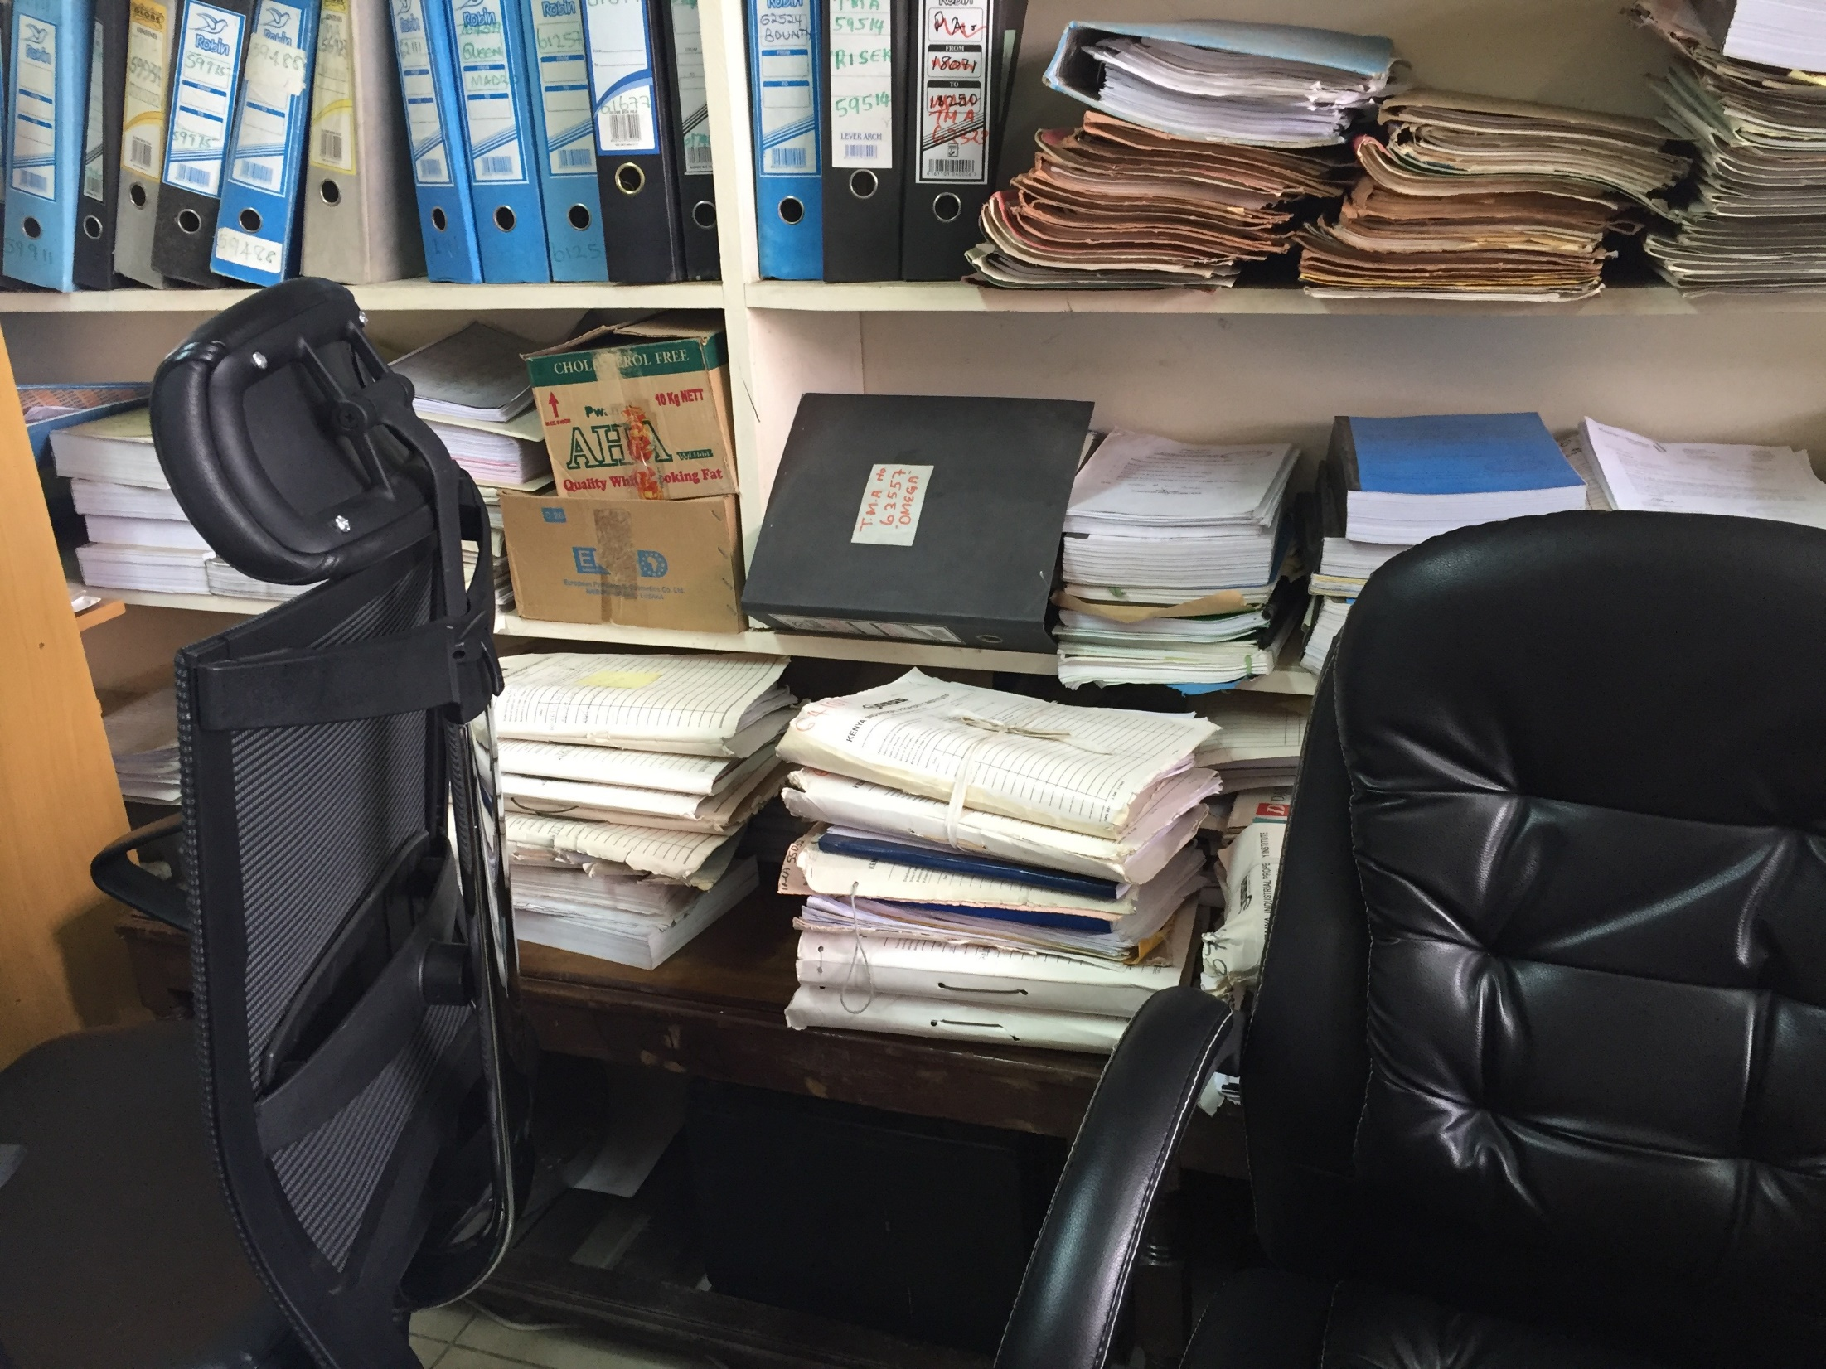

Slide 10
IP Office Digital Transformation

Slide 11
IP Office Functions and Services

Slide 12
What is IPAS?
IPAS (Industrial Property Automation System) is a software developed and Supported by WIPO for the complete administration of IP rights in an IP Office.
It covers the management of trademarks, patents, industrial designs, utility models. IPAS is designed as an IP case management system hence can be extended to support other IP domains like Copyright, and Geographical Indications.
Functionalities and Services
Case Data Management (Key-in, Change, Business rules, Log, Persist in Database)
Workflow (Case lifecycle aka Status Transition)
Office Notifications / Letters
Examination
Publication
Issue of Certificate
Query (Bibliographic Data and Codes: Nice, Vienna, Locarno, IPC )
Trademark Search Report (Including Phonetic)
Fee – Payment Recording
Document Tracking
Import International Trademark (Madrid and ARIPO)
Statistics
User-Authorization Management
Patents / Trademarks etc.
International Trademark & PCT
Opposition
Registration-Record-Renewal
Patent
Industrial Design
Utility Model

Slide 13
More IPAS Features
Processing Renewals of trademarks and industrial designs
Processing assignments, merger, change of name and/or address, etc…etc.
Annuities generation and payment tracking
Journals/Gazettes preparation
Pre-Filing Search
Dossier Tracking
Productivity Report
Yearly Statistic Report
Linkage with electronic document management system

Slide 14
IPAS Customzation
Extensive customization including:
  National IP laws, Regulations / Administrative Procedures,
  Workflow processes, legal time-periods and deadlines,
  Templates of official correspondences (Office Notifications & Letters), certificates, gazettes,
  Language, terminology
No programming is required to customize IPAS

Slide 15
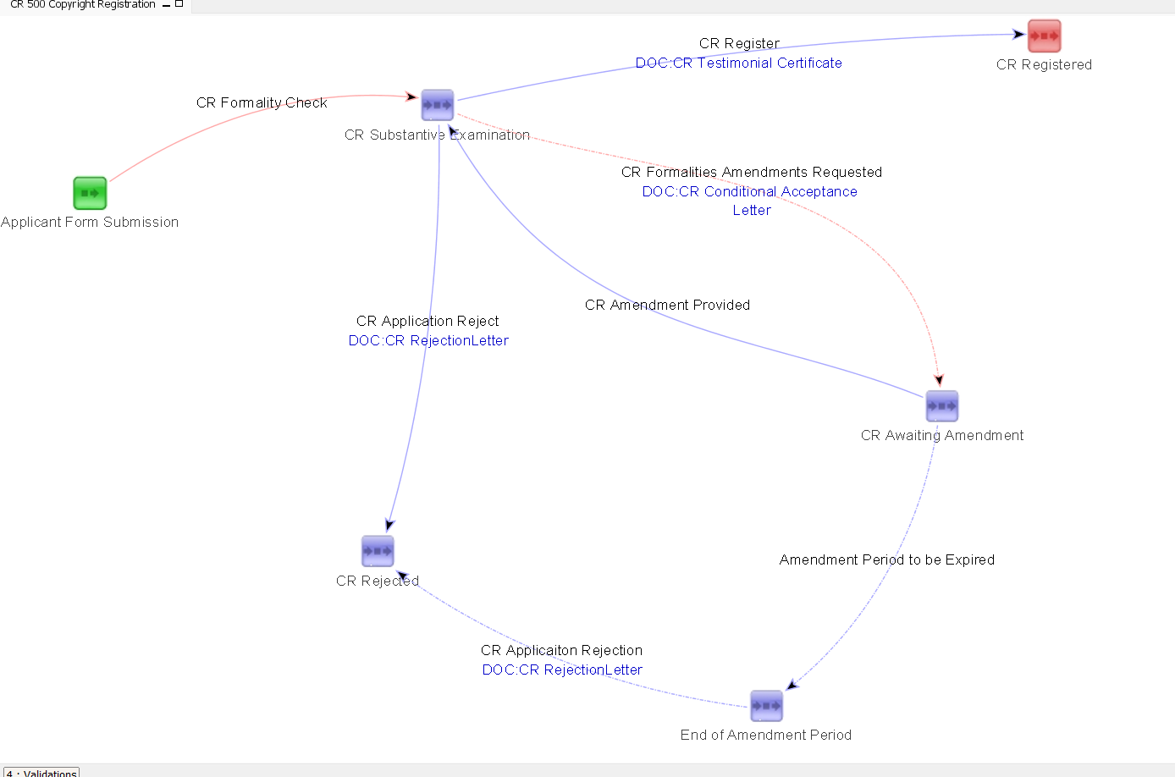
Copyright Workflow in IPAS

Slide 16
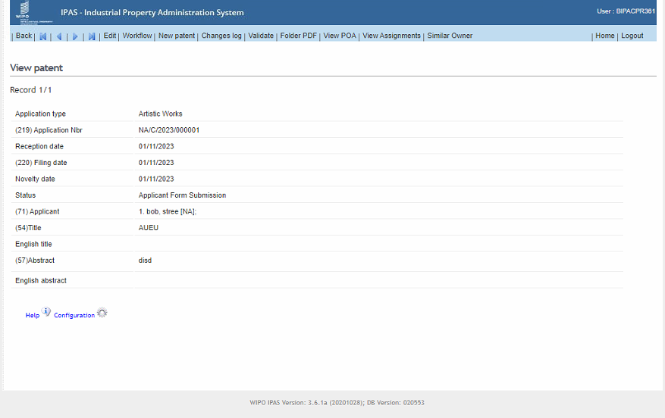
Copyright Administration in IPAS

Slide 17
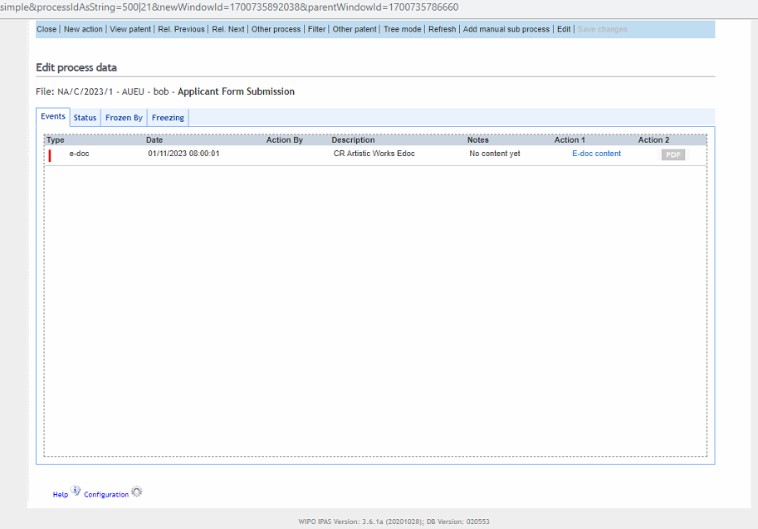
Copyright Office Action in IPAS

Slide 18



WIPO File PCT National Phase Integration
Reception Module
PCT National Phase Download
Internet
IP OFFICE
WIPO

Slide 19
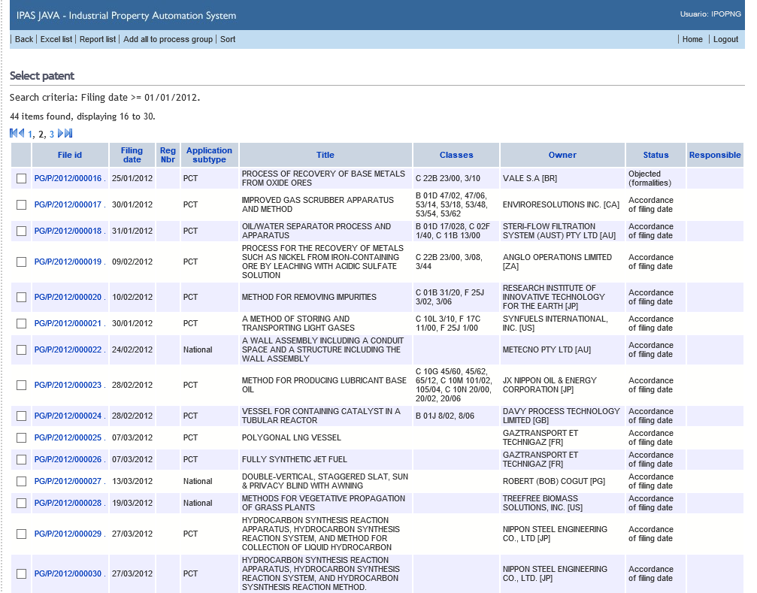
IP Records in IPAS

Slide 20
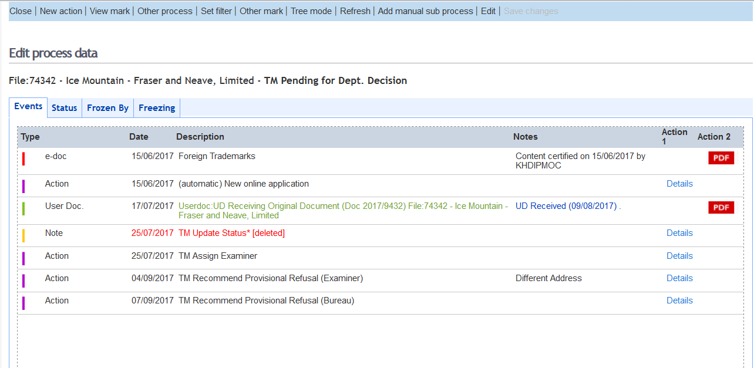
Automated Office Actions
Notes:
20

Slide 21
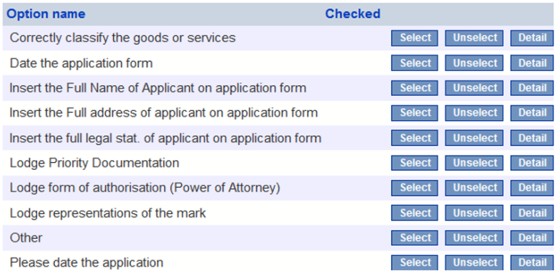
IPAS Data Input Verification – Check List

Slide 22
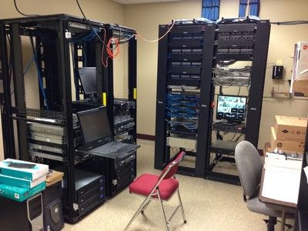
IPAS Onsite Deployment

Slide 23

IPAS 4 – Cloud Hosted
Notes:
We have been held back for years by our lack of good IT infrastructure.
That’s all changed now.
The biggest cloud service provider (AWS) has more than 200 data centres and more than 2 million servers.
You can rent by the hour, and pay around $5000 per year for the equivalent of a modern, high-tech data centre.
At WIPO we have already achieved cost savings of up to 80% on some of our applications by moving to the cloud.
What does this mean for us:
We can focus on the business instead of servers, cabling, backups, etc.
Much faster to deploy new services such as online filing.

Slide 24
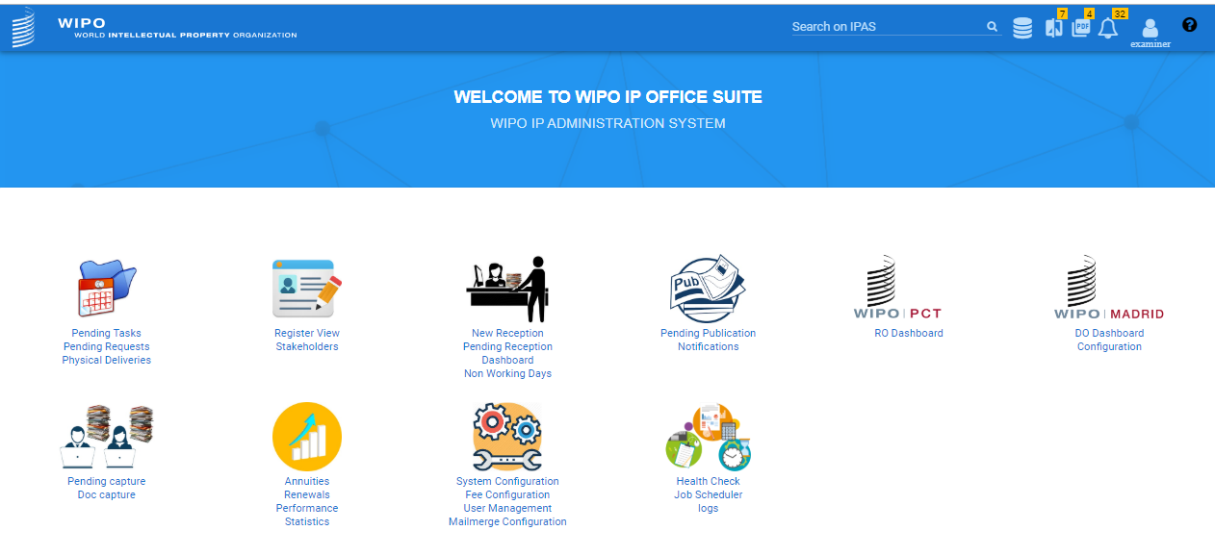
IPAS 4 – Cloud Version
Tailored by work function
Examiner tools and productivity
Business process management

Slide 25
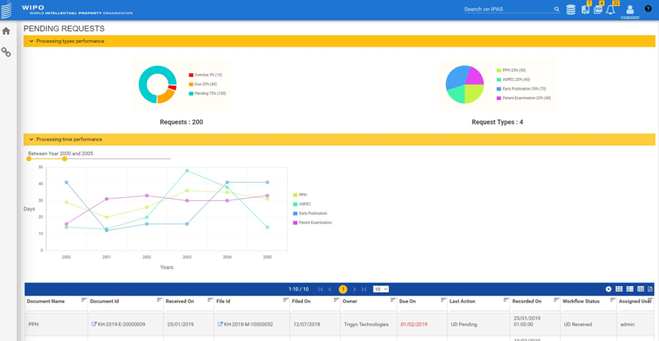
Productivity Statistics

Slide 26
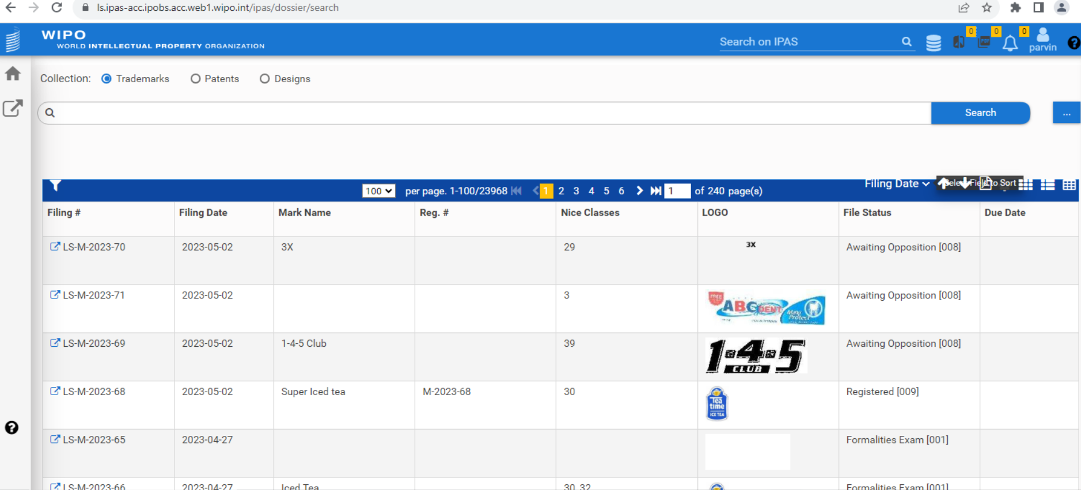
Lesotho – IPAS 4 (Cloud) Implementation

Slide 27
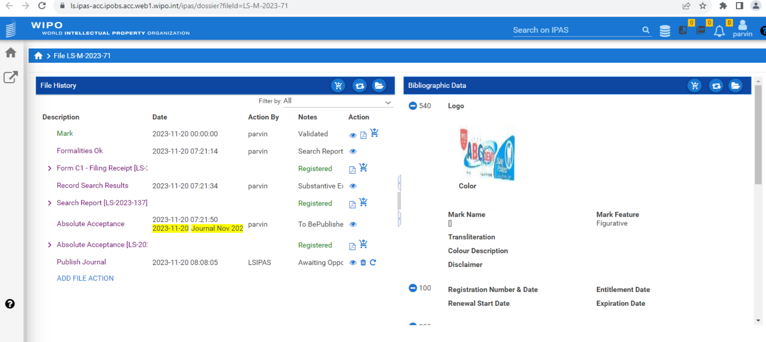
Lesotho – IPAS 4 (Cloud) Implementation

Slide 28
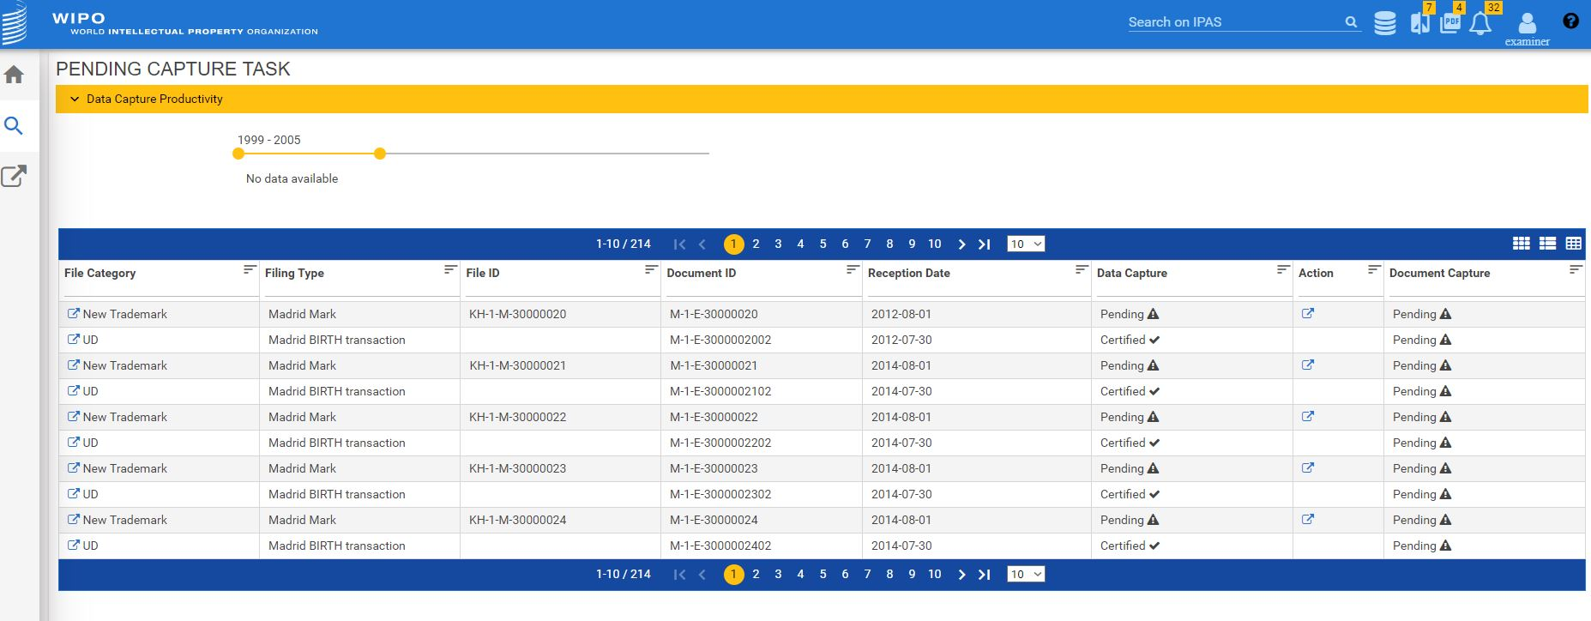
IPAS Files / Docs Pending Capture

Slide 29
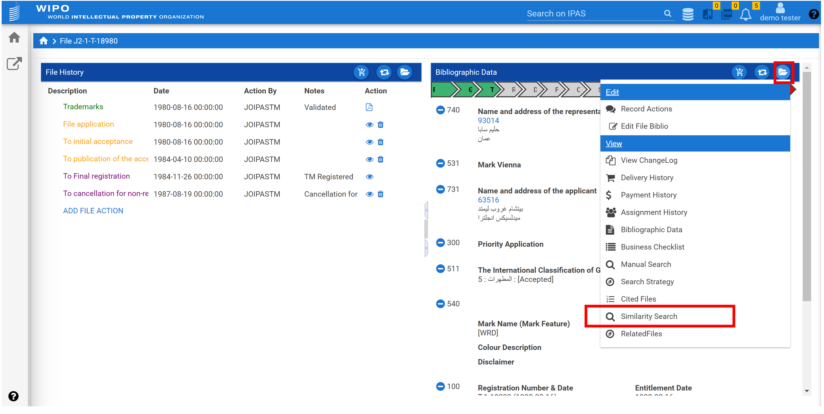
IPAS 4 Automated Search

Slide 30
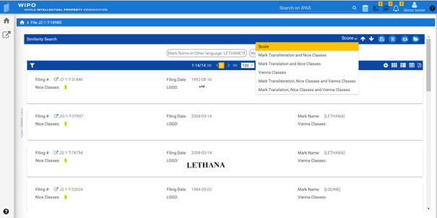
IPAS 4 Automated Search Results

Slide 31
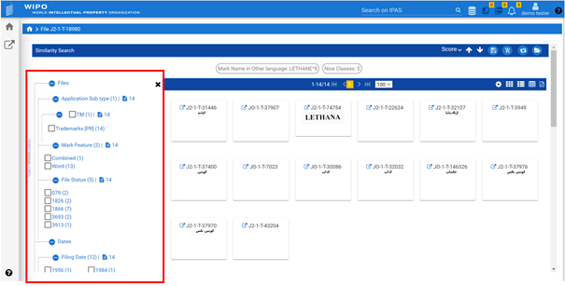
IPAS 4 Customizable Search Results

Slide 32
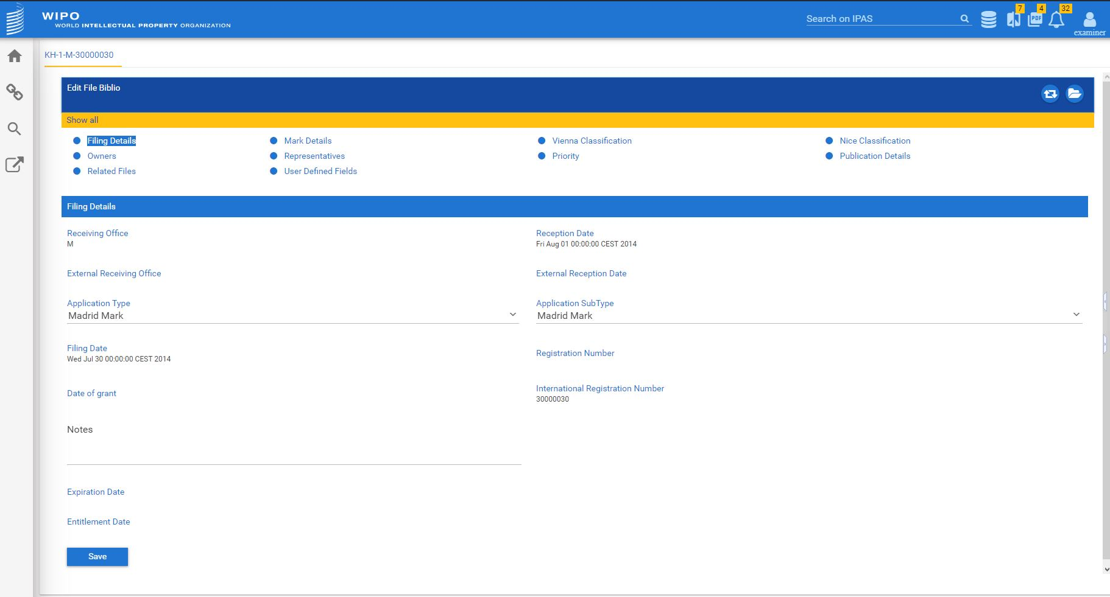
IPAS 4 New Application View

Slide 33
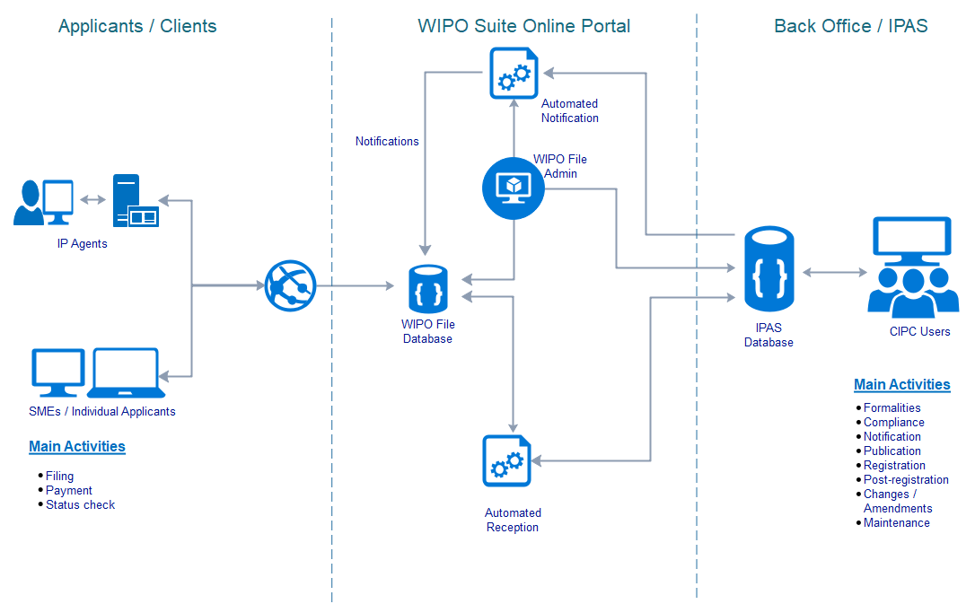
What is WIPO File?

Slide 34
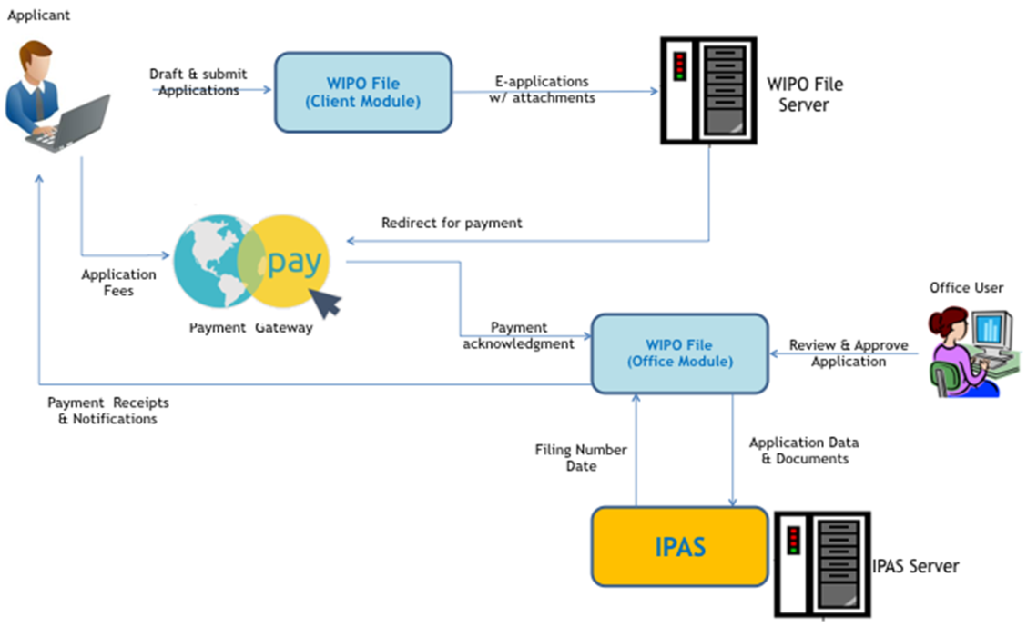
WIPO File
  Online filing by local agents of industrial design, patent and trademark applications and subsequent requests
Notes:
34

Slide 35
Online Filing Services for Local Agents
Drafting and submission of new application of industrial designs, patents and trademarks, with required supporting documents
Post-filing requests including renewal, payment of annuities, change of owner, change of representatives, amended claims, description, etc.
Viewing, filtering, management of e-filing requests in portfolios and workbench
Possibility to receive online Office correspondences in response to e-filing requests.

Slide 36
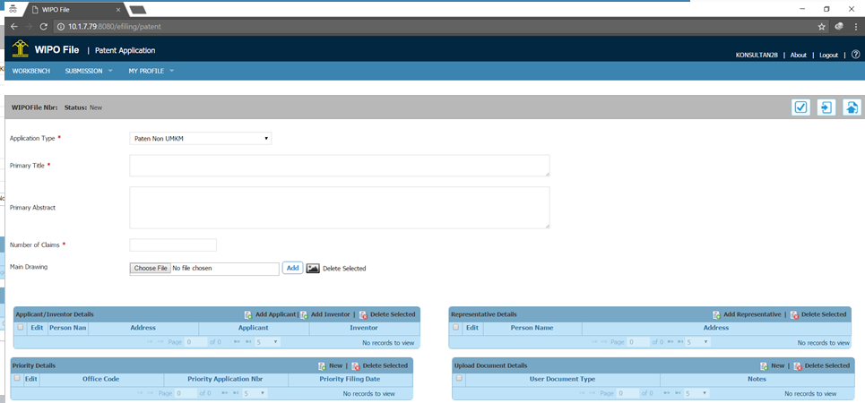
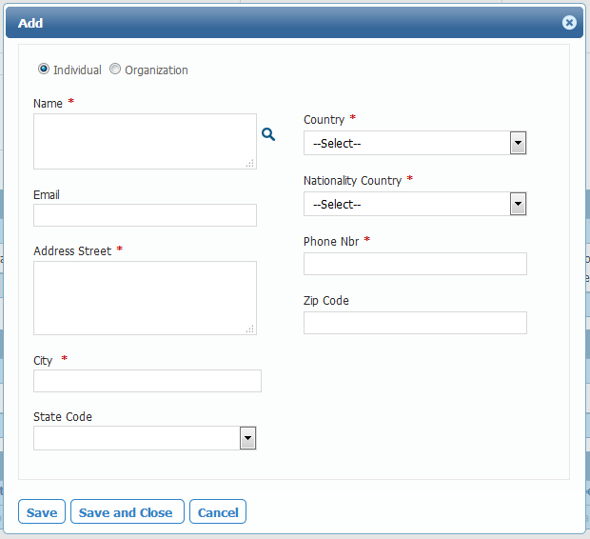
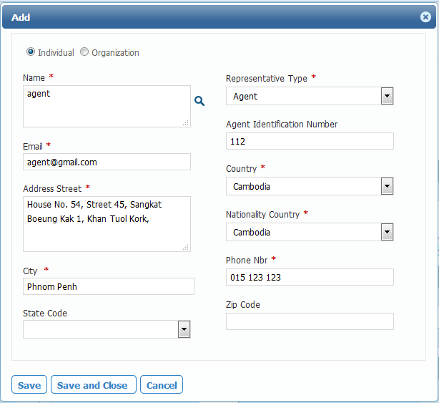
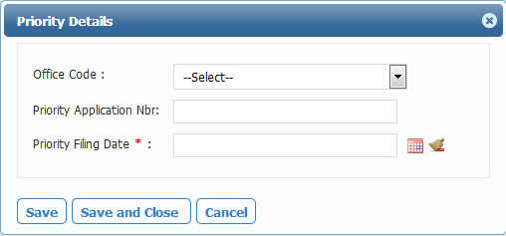
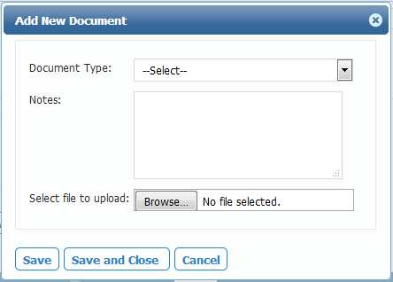
New Patent Application Form
Notes:
36

Slide 37
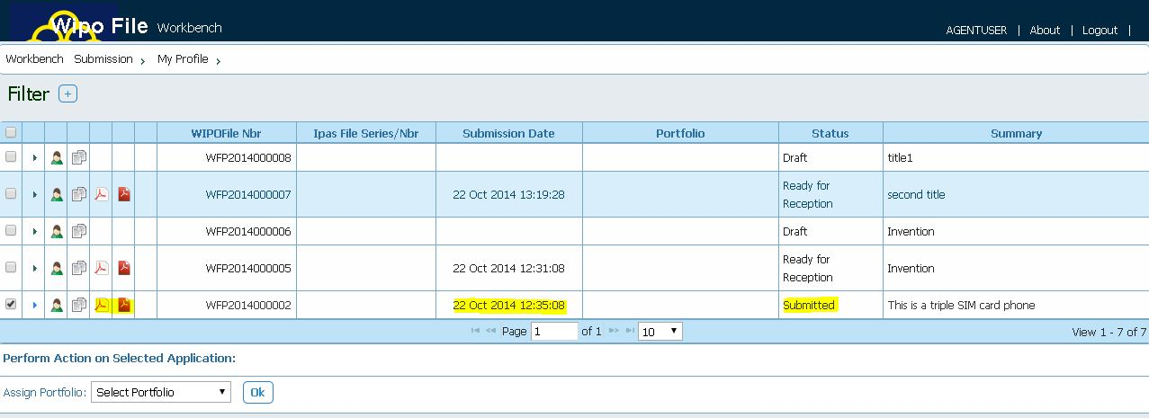
Fee Calculation and Offline Payment
Submissions and follow-up (submitted, accepted/rejected, pending payment, ready for reception, received)
Notes:
37

Slide 38
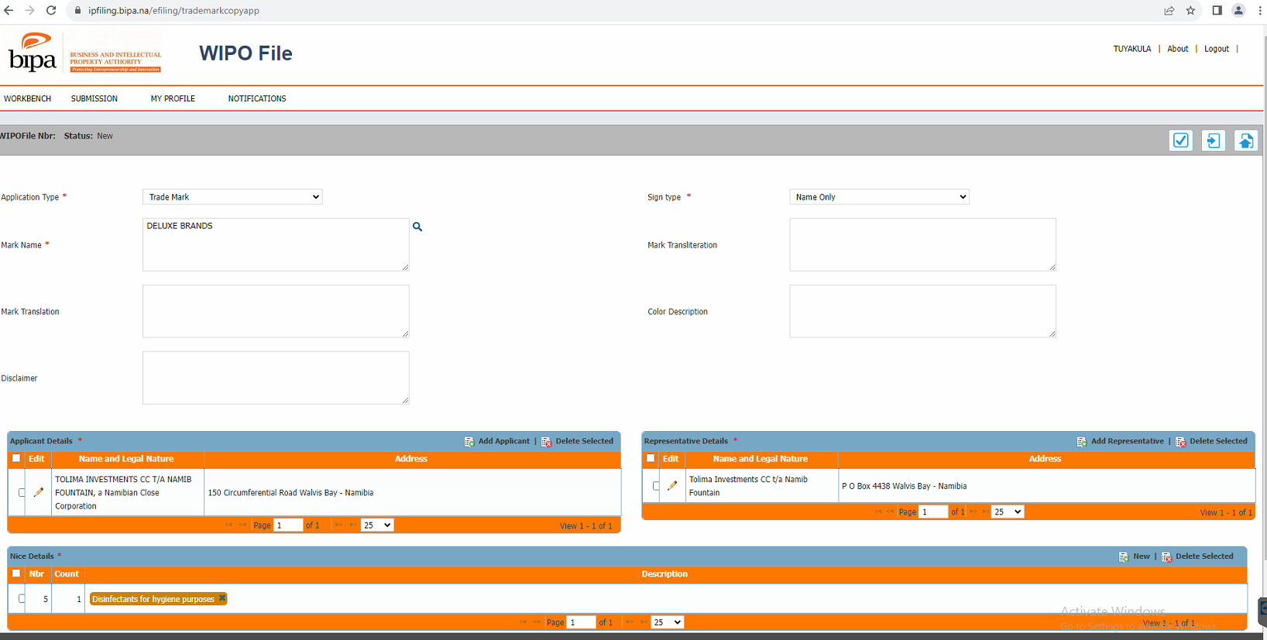
Namibia – WIPO File Implementation for Trademarks

Slide 39
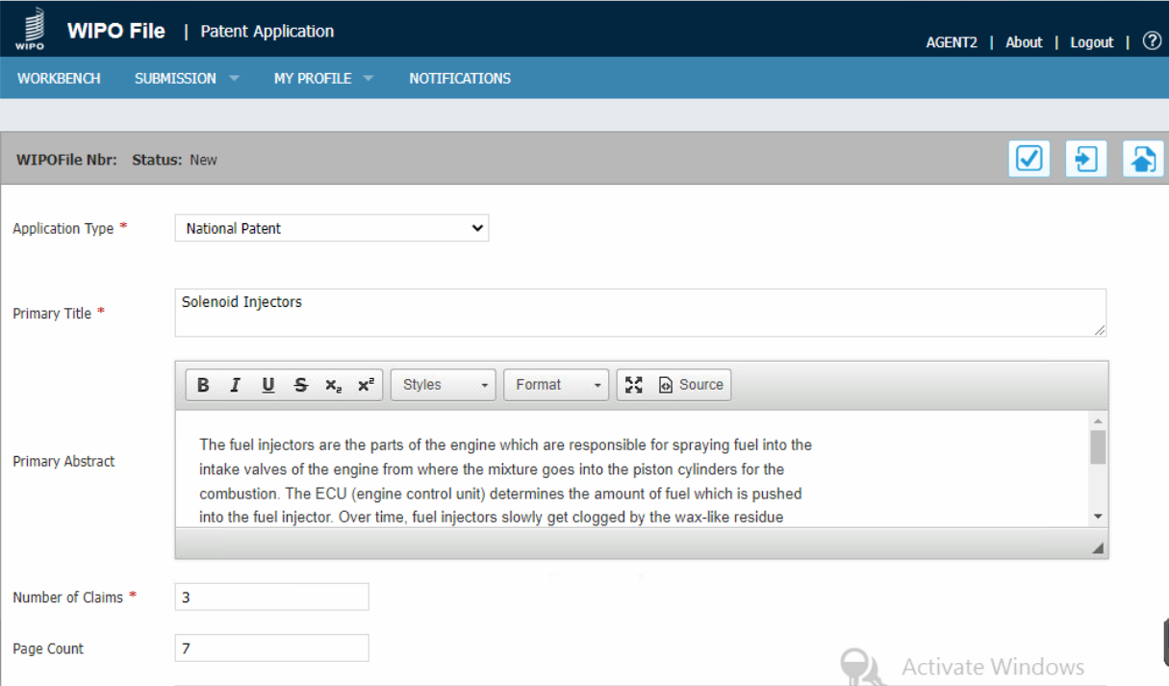
Kenya – WIPO File Implementation for Patents

Slide 40
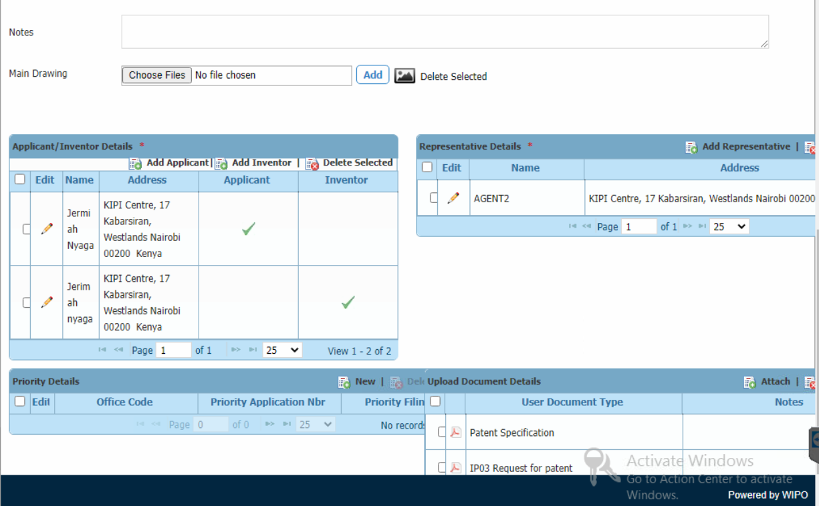
Kenya – WIPO File Implementation for Patents

Slide 41
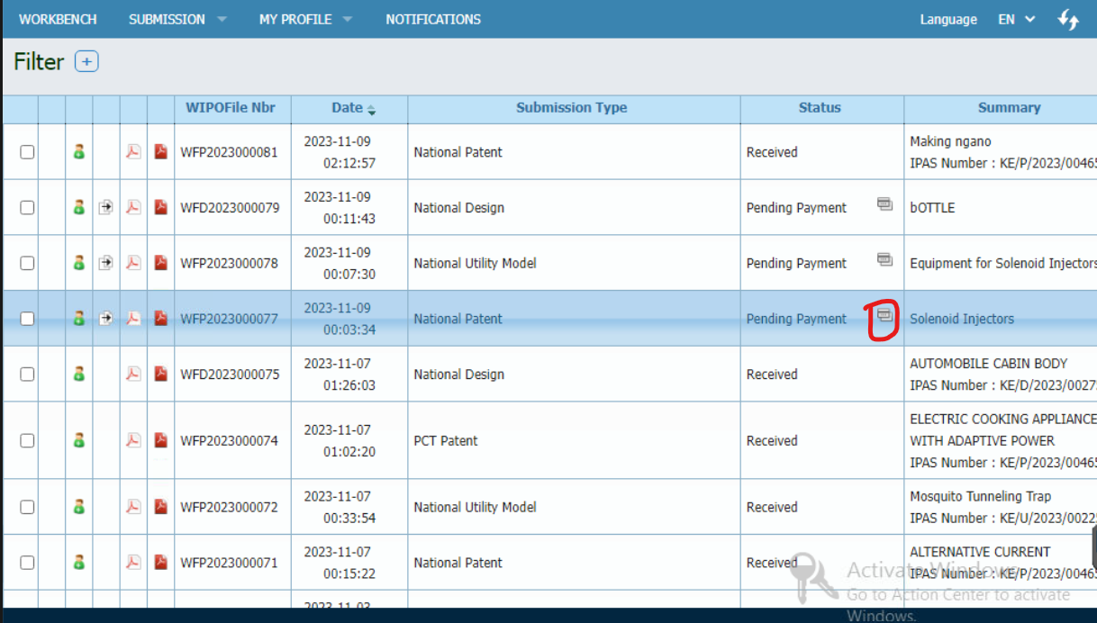
Kenya – WIPO File with Online Payment Integration

Slide 42
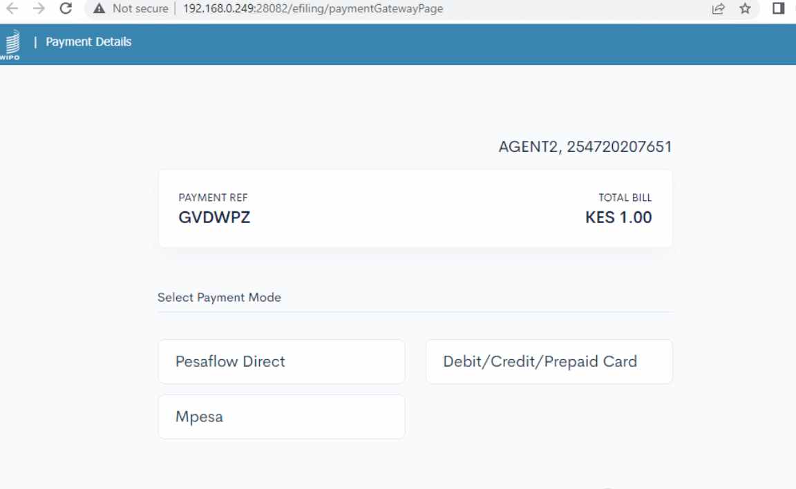
Kenya – WIPO File with Online Payment Integration

Slide 43
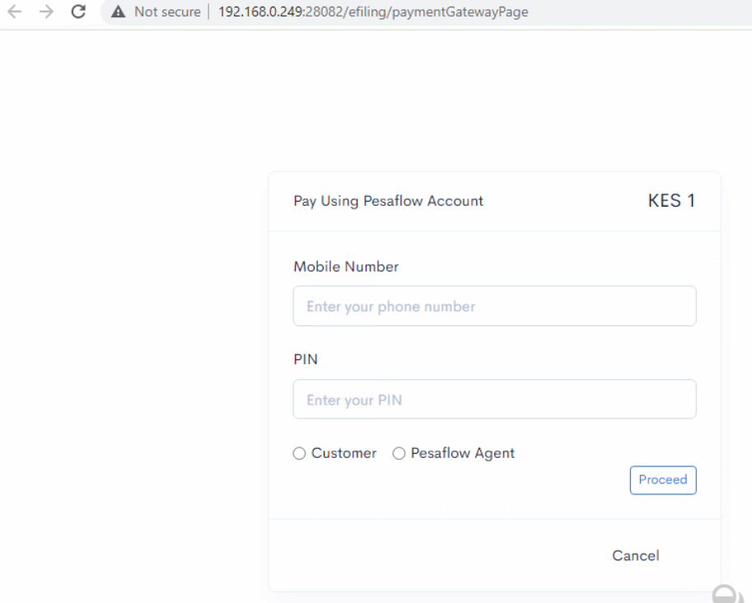
Kenya – WIPO File with Online Payment Integration

Slide 44
WIPO File Considerations
Legal Framework
  Electronic transactions law, electronic payment, signature, IP regulations…
Payment and Reception Model
    Online data capture, or legally valid filings? Service for registered agents, or for any user?
Office pre-requisites
    Secure web site, robust infrastructure, support staff, …
Deployment and Testing
    Customize system, fee calculation, payment integration, register users, outreach events, testing,…

Slide 45
What is WIPO Publish?
Public search,
Fully customizable
Online Gazette, legal status
WIPO, international and regional databases
WIPO, international and regional databases
Online Search
Legal Publication
Data Sharing
Document Server
Data and Document Storage
Trademarks, Patents and Designs
XML, WIPO Standards
Configurable rules
Automatic Scheduling
Data Extraction and Formatting
IP Administration System e.g. IPAS

Slide 46
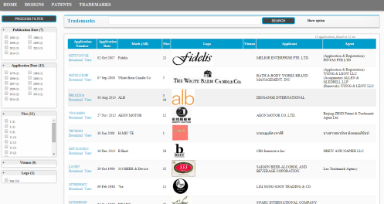

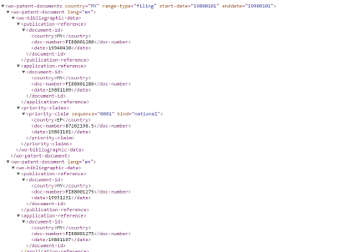
WIPO Publish
enabling offices to make IP data available nationally and internationally
Registration of
Trademark, Design and Patent applications
OFFICE Staff
WIPO IPAS
WIPO CASE
Data Extraction
Publication Server Web Search
Data Sharing with WIPO
Online
Publication
WIPO Publish
Publication Server Rest Services

Slide 47
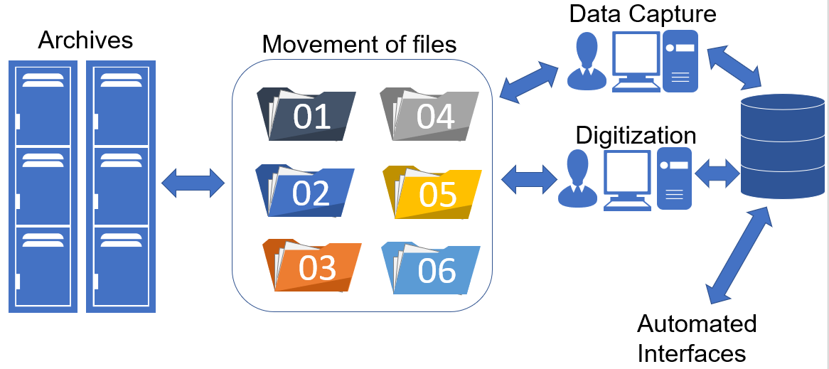
From Paper Registry to Electronic Registry

Slide 48

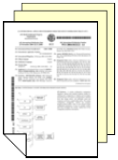

WIPO Scan, WIPO Publish EDMS and IPAS
Fully Paperless Processing
Frontfile / Incoming Scanning
WIPO Scan
IPAS EDMS
IPAS
Electronic document generation
Backfile / Backlog Scanning

Slide 49


WIPOScan Basic Workflow
Scanning
Document
Indexing
Image
Enhancement
Document
Subsection
Indexing
Export to
EMDS

Slide 50
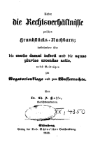
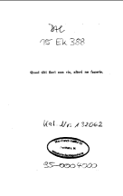
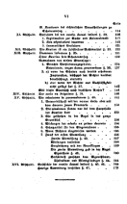
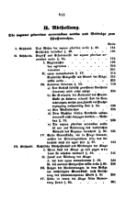
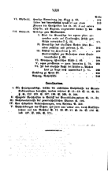
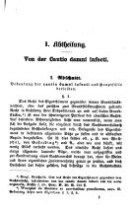
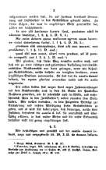
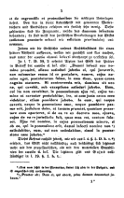
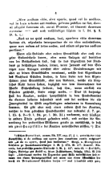
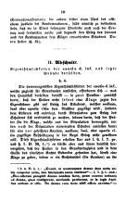










WIPOScan – Document Section Indexing e.g. Patent Document
BIBLIOGRAPHIC DATA
DRAWINGS
DESCRIPTION
CLAIMS

Slide 51

Fully customizable and configurable

Slide 52

Fully customizable and configurable

Slide 53

Fully customizable and configurable
Search Term

Slide 54


WIPO Publish Regional Configuration
Office A
Office B
IPAS
Other IP Administration Systems
IPAS
EDMS
IPAS Data
Extraction
Module
WIPO Publish Server
WIPO Publish Server
Office C
IPAS
IPAS Data
Extraction
Module
IPAS
EDMS
Scheduled
Automatic
Download and update
WIPO Publish Regional
Front End
Search User Interface

Slide 55







What is IPAS Madrid Module?
New application or Request for Changes
Applicant
Designated Contracting States
Limited information made available to public using IPAS at the Office
Office of Origin
Using WIPO IPAS
Mozambique
MADRID
Notifications
Rwanda
IPAS Madrid Module
Internet
Office examiners access IPAS via web browser
WIPO
OAPI
Namibia
Kenya

Slide 56

Madrid Workflow for Office Notifications

Slide 57

Madrid Outgoing Notifications to the International Bureau of WIPO
Upload decisions to IB: From IPAS version 3.6.1, it is possible to automate the transmittal of decisions from the designated office (DO) to the International Bureau (IB)

Slide 58
Madrid Outgoing Notifications to the International Bureau of WIPO
Upload decisions to IB: From IPAS version 3.6.1, it is possible to automate the transmittal of decisions from the designated office (DO) to the International Bureau (IB)

Slide 59
IPAS Madrid Dashboard
Madrid incoming dashboard : User can view the data related to Madrid incoming in form of charts. Two kinds of charts could be shown – one is incoming transactions chart for on hold transactions and the other is for pending transactions. These doughnut charts display bifurcation based on the transaction type of the transaction

Slide 60

IPAS Madrid – Madrid Incoming Dashboard

Slide 61
IPAS Madrid Incoming Dashboard
  Dashboard displays incoming data in grid format. User can filter the records on the dashboard using Set Filter link. Data on the screen can be exported in an excel using the Export Excel link on the top. The error message shown in the grid as Tooltip will be exported as error message column

Slide 62

IPAS Madrid: Incoming Dashboard

Slide 63

IPAS Madrid Improvements : Madrid Outgoing Dashboard
Madrid Outgoing Dashboard: In IPAS 3.6.1 user can view Madrid decision which are due on next 12 months or 18 months(depending on the configuration) on outgoing linear chart

Slide 64

IPAS Madrid: Madrid Outgoing Dashboard

Slide 65
IPAS Madrid - Support for Irregularity Notification
Support for Irregularity notification: Earlier IPAS Madrid modules did not process the Irregularity Transactions. IPAS 3.6.1 provides support for processing the Irregularity transactions. Using IPAS designer user can define the user document that will be processed at time of Irregularity transaction. Madrid application downloads Irregularity transactions from FTP and will process Irregularity transactions, after processing user can view Irregularity transaction on incoming dashboard

Slide 66

IPAS Madrid: Support for Irregularity notification

Slide 67














IP Office Digital Transformation
Model Office : IPO Front Office
Online Service
(Internet)
IPO BackOffice
Application
Receiving
Document
Digitization
Formality
Checking
Applicant/
Agency
Mgmt.
Industrial Property Automation System (IPAS)
Document
Processing
Office Staff
Applicant
Application
Tracking
Application Receiving
Document Digitization
Formality Checking
Examination
IPAS Automation Platform
Examiner
Agents
IPAS
IPAS EDMS
IPAS Publication Server
IPAS Work Flow Designer
WIPOFILE
IPAS+ (Reception, PCT, etc)
Madrid Module
Registration
Searching
Information
Search
Analytics
Manager
Notification
Publication
Examination
Internet User
z
IPAS Database
Worldwide
Data Center
IT Personnel
Document
Archive
Search
Index
System
Configuration
WIPO
Other Coop. Part

Slide 68
Thank you for your attention

