Slide 1

Instituto da propriedade industrial

Slide 2
AUTOMATION STATUS IN MOZAMBIQUE
By Calvina Give
Mozambique, Maputo, 20 to 24 April 2026

Slide 3
The IPI
Establishment: The IPI was established by Decree No. 50/2003 of November 24
IPI: is a public institution, operating under the sectoral oversight of the Minister of Economy (institutional restructuring led to the transfer of responsibility from the Ministry of Industry and Commerce to the Ministry of Economy) and under the financial oversight of the Minister of Finance
Mission: Administration and registration of industrial property rights
Human Resources: there are currently 63 employees, distributed among the headquarters and regional offices
Headquarters: 54
Regional Delegation - Center: 5
Regional Delegation - North: 4

Slide 4
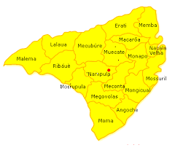
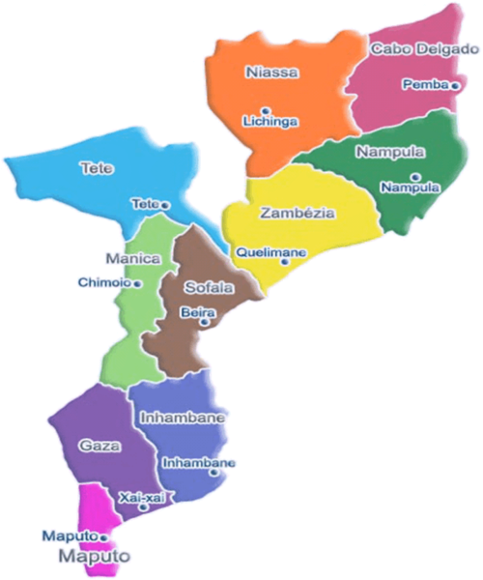

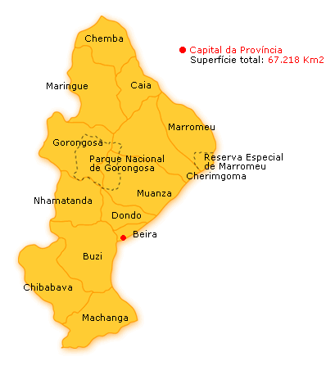
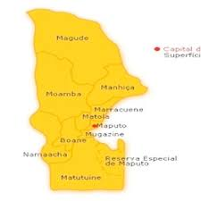

Geographic Location
=4
Regional Delegation - North: Nampula
=5
Regional Delegation - Center: Beira
=54
Headquarters: Maputo

Slide 5
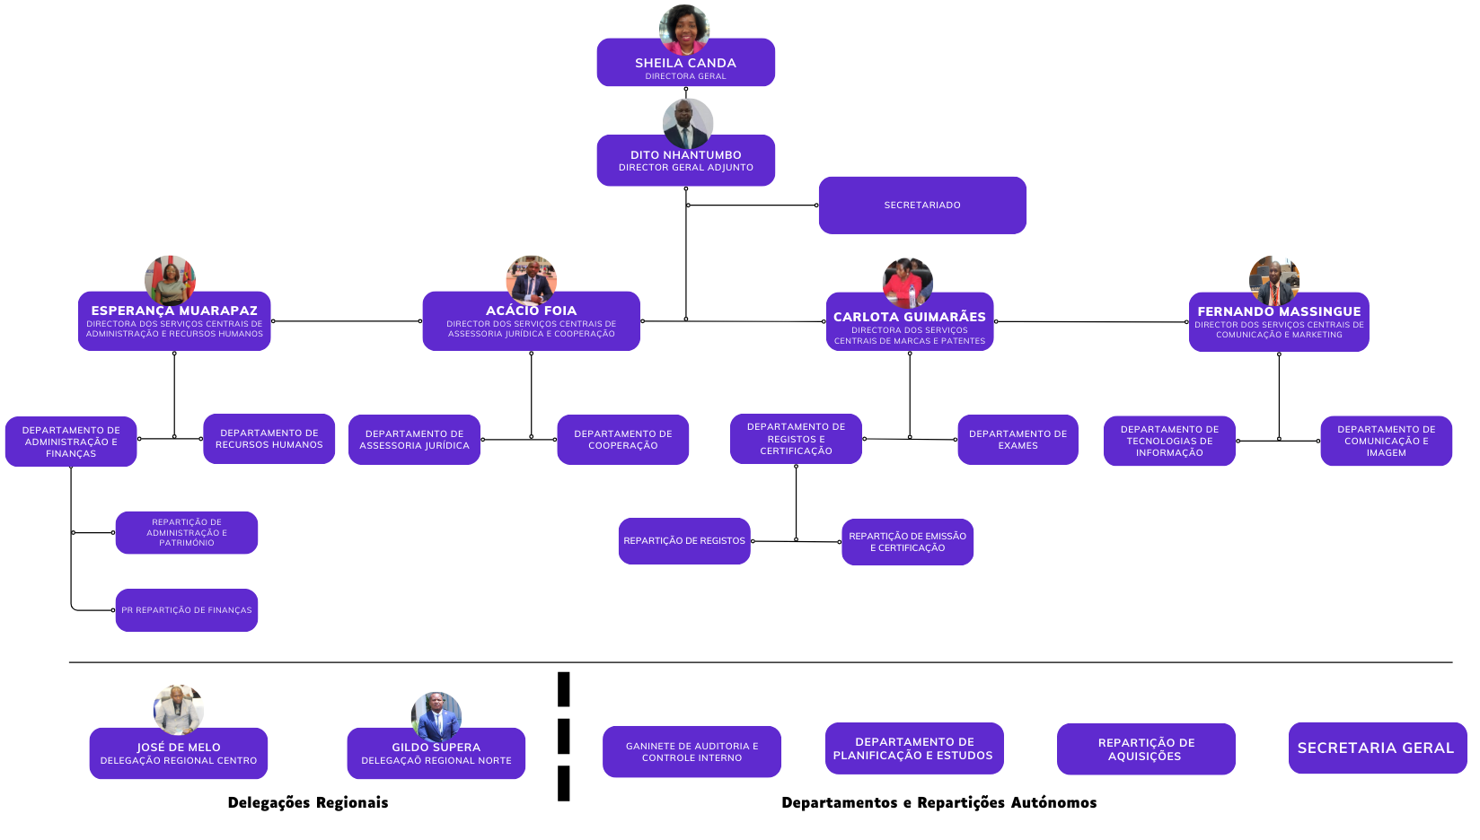
Organic Structure

Slide 6
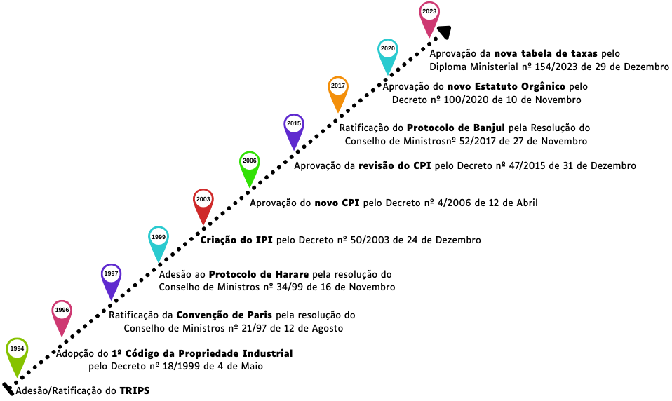
Legal Legal Framework

Slide 7
Evolução do Sistema de Automação da PI
1999 a 2005 – Manual system
Paper reception
Use of excel worksheet
Manual numbering
2006 – Introduction of IPAS Centura
Electronic reception but paper is required
Numbering via IPAS

Slide 8
Evolution of the IP Automation
2012 – Migration from IPAS Centura to IPAS Java
2015 – Integration of EDMS Module
2018 – Digitization
2019 – Integration of ARIPO MS Module
2019 – Integration of WIPO Publish
2026 – Migration to IPAS4

Slide 9
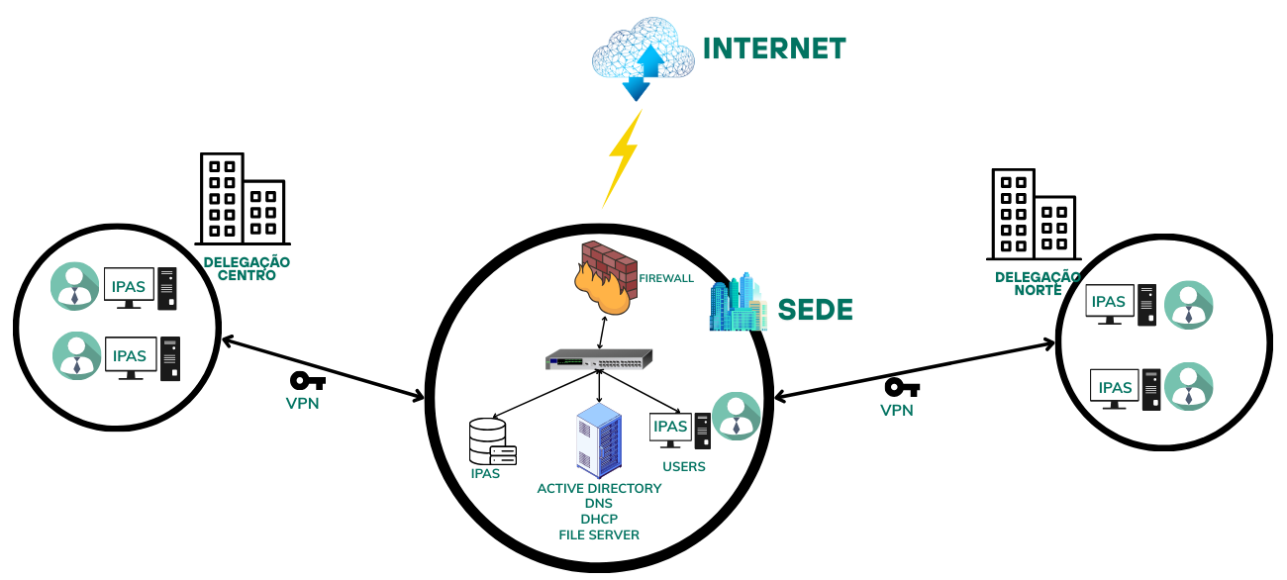
IT Infrastructure

Slide 10
Current Situation
IPAS4 in use
System acceptance by users

Slide 11
Challenges
Some functionalities missing

Slide 12
Future Plans
Implement online registration

Slide 13

Thank you for staying with us until the end. Your presence means the world to us.

