Slide 1

DATA QUALITY CHALLENGES & SOLUTIONS
Presented by :
Bongani Mnguni
Tuesday, 21 April 2026

Slide 2

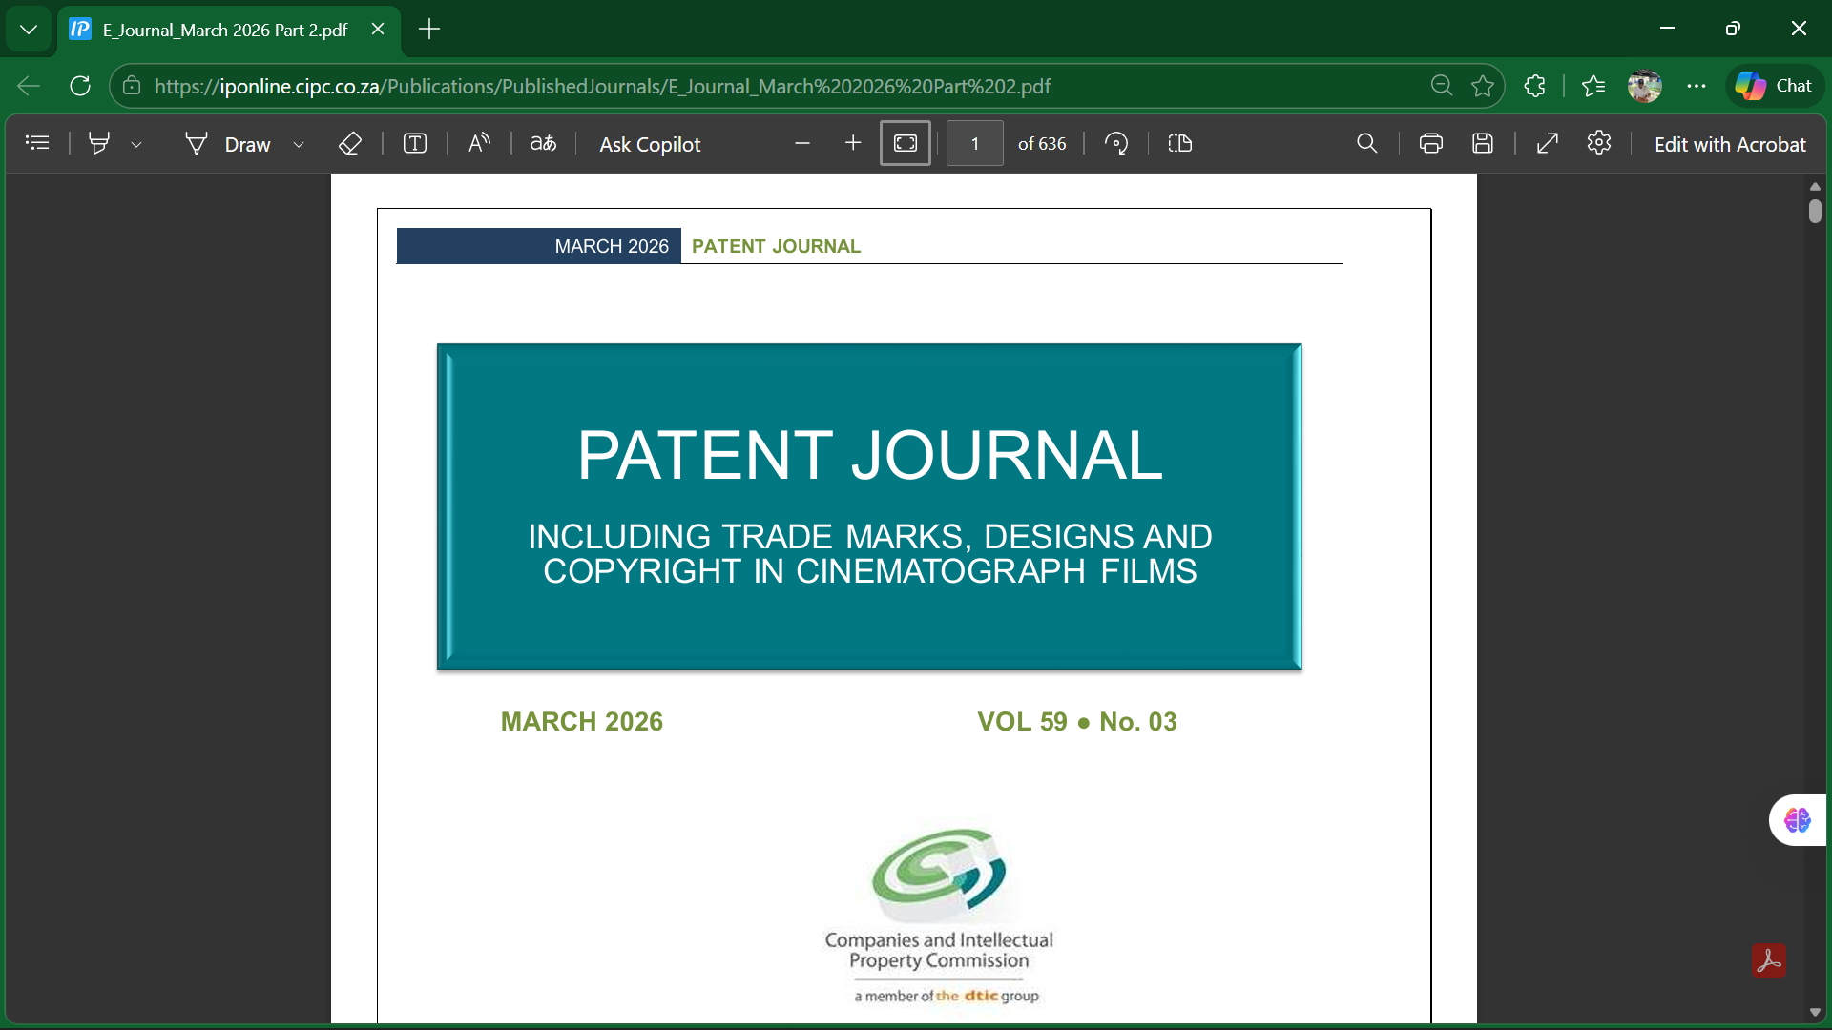


Data : Patent Journal

Slide 3
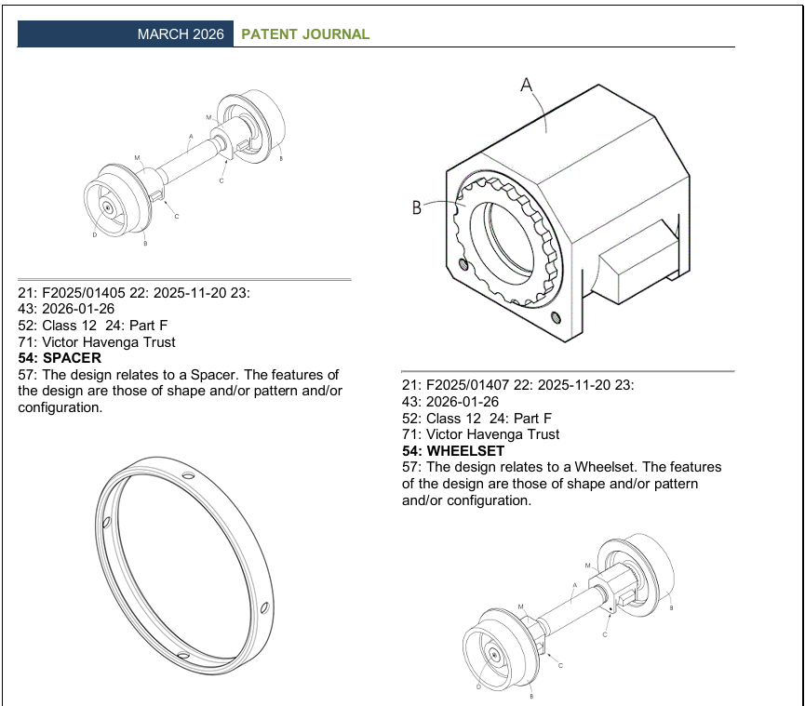
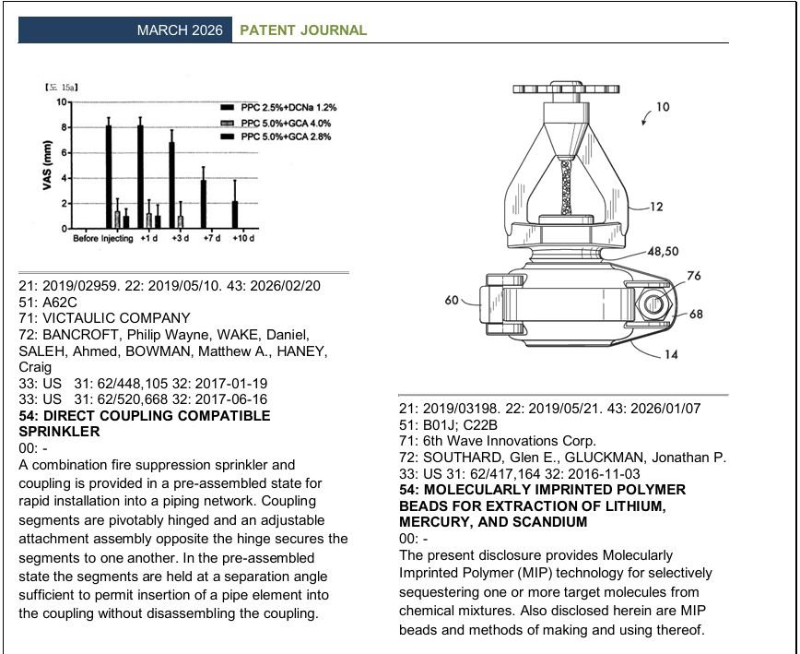
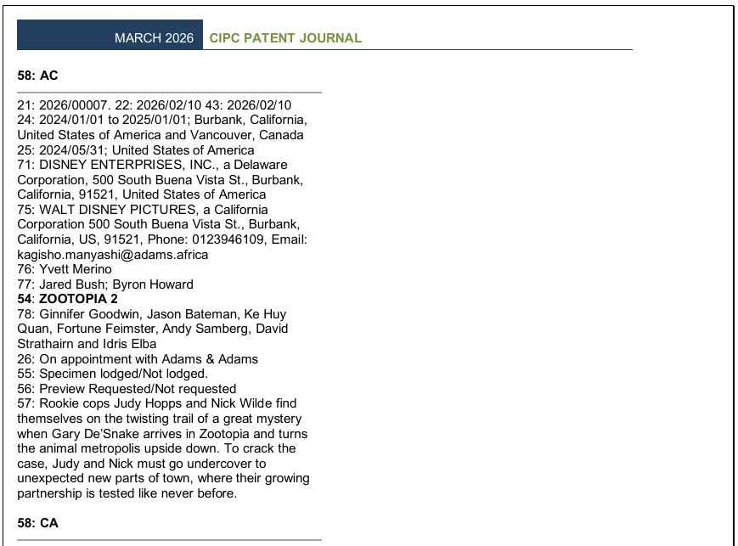
Data : Patent Journal
Patents
Designs
Copyright

Slide 4
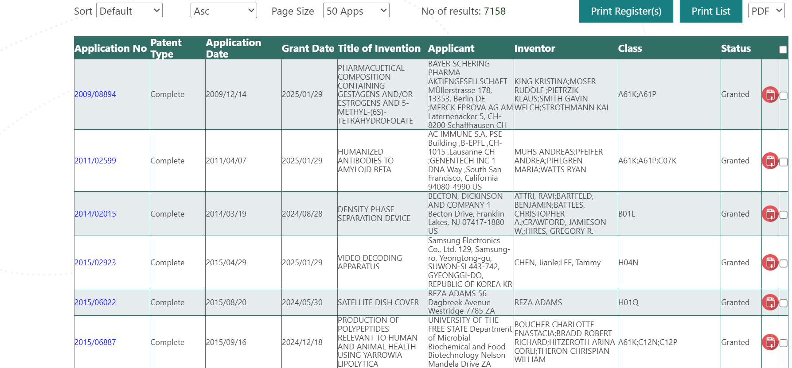
Data : IP Online

Slide 5
DATA QUALITY CHALLENGES & SOLUTIONS
Real-time data synchronization (RTDS)
Some processes are handled manually in the office and are not always updated on the system in real time.
As a result, the database may contain outdated or inaccurate information, such as incorrect patent status details.
Data Quality of our patent register
Depository system is the core quality risk: SA does not substantively examine patent applications patents are granted on the correctness of the specification as submitted. A patent in the SA register does NOT mean the invention is novel or non-obvious.
Possible Solutions
Once all processes, including current manual patent processes, are fully automated, RTDS will be achieved.
Possible Solutions
Introduction of SSE

Slide 6
DATA QUALITY CHALLENGES
Trademark Data Quality Issues
Historical paper records scanned and digitised OCR errors introduced incorrect applicant names, classes and dates.
Duplicate trademark records: Same mark filed by different agents with slight name variations for the same owner creates conflicting entries in the register.
Trademark classes: Older filings do not consistently follow all Nice Classification fields missing sub-class data complicates searchability for a regional register.
Publication in the Patents Journal (gazette): Historically paper-based gazette led to incomplete digital records for older marks.
Agent/attorney data: IP attorneys file on behalf of clients agent details not always updated when firms merge or change. Stale contact records.
Patent Data Quality Issues
Depository system is the core quality risk: SA does not substantively examine patent applications patents are granted on the correctness of the specification as submitted. A patent in the SA register does NOT mean the invention is novel or non-obvious.
Missing INID codes: Some older patent records lack full bibliographic data fields (WIPO INID codes ST.9 standard). Incomplete data is a barrier to interoperability.
Assignment and licensing records: Not always updated promptly register may show original applicant even after rights have been transferred.

Slide 7
DATA QUALITY CHALLENGES
Design Data Quality Issues
Aesthetic vs. functional design categories sometimes incorrectly classified by applicants manual review needed.
Design images: Older registrations have poor-quality scanned drawings not machine-readable or searchable by image.
Duration records: Registered designs have limited terms
  Lapsed designs not always clearly flagged in the online register.
Copyright Data Quality (Special Case)
SA has no formal copyright register copyright arises automatically on creation (no registration required under Copyright Act 98 of 1978).
CIPC's voluntary copyright notification service captures some data but is incomplete most copyright works are NOT recorded anywhere.

Slide 8


Slide 9



