Slide 1

STATE OF AUTOMATION IN SOUTH AFRICAN IP OFFICE
Presented by :
Mr. Bongani Mnguni
Monday, 20 April 2026 / Wednesday, 22 April 2026

Slide 2

BACKGROUND: JOURNEY FROM PAPER TO DIGITAL
  CIPC's predecessor (CIPRO) was entirely paper-based for all IP filings, physical delivery, postal or courier only.
  IP clients had no online tracking; mean time to respond (MTTR) was extremely high; litigation exposure grew due to delays in issuing rights.
  CIPC modernisation programme progressively migrated IP processes from legacy paper systems to digital platforms.
  Online IP applications now available for: Trademarks, Patents, Designs and Copyright-in-Film, accessible via the CIPC e-services portal (www.cipc.co.za).
  Trademark applications: Online filing introduced tracks application status, responses to office actions, and publication in the Patents Journal.
  Patent applications: Online filing available however SA operates a DEPOSITORY SYSTEM, applications are registered without substantive examination.
  Designs: Registered and unregistered designs both administered via CIPC portal, aesthetic and functional design categories.
  Copyright: Voluntary notification service for copyright works introduced online. SA does not have formal copyright registration; copyright arises automatically on creation.
  Self-Service Terminals (SSTs) deployed in Pretoria, Johannesburg and Cape Town with biometric verification - includes IP-related services.

Slide 3

CURRENT LEVEL OF AUTOMATION
  Trademark and design applications: Most advanced in terms of online processing forms, fees and tracking are functional online.
  Patents: Online submission improved but processing backlogs remain due to the volume of applications and manual examination of specifications.
  Copyright: Most limited automation voluntary notification only;
Notes:
Source: CIPC IP e-services portal: www.cipc.co.za → Intellectual Property → confirms which IP types are online
Source: CIPC Annual Report 2024/25: www.cipc.co.za/index.php/about-us/annual-reports/ look for IP filing statistics, automation milestones
Source: Automation of IP Admin at CIPC (technical paper): search billetteriesoftware.com for CIPC IP Admin System automation case study details MTTR problem and solution
Source: WIPO IP statistics for South Africa: www.wipo.int/ipstats → country profile → number of trademark/patent/design applications

Slide 4
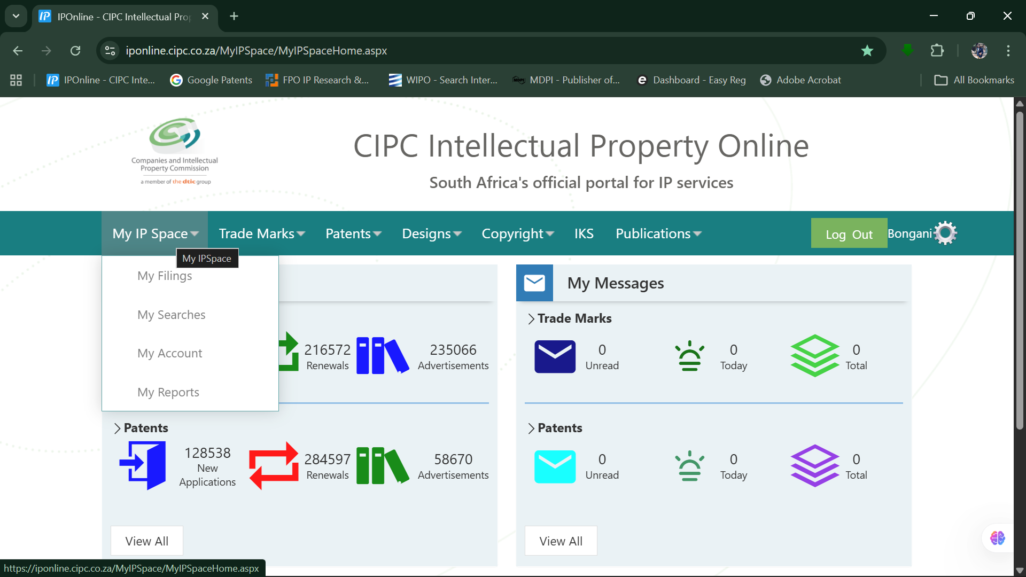
CURRENT LEVEL OF AUTOMATION: IP ONLINE

Slide 5
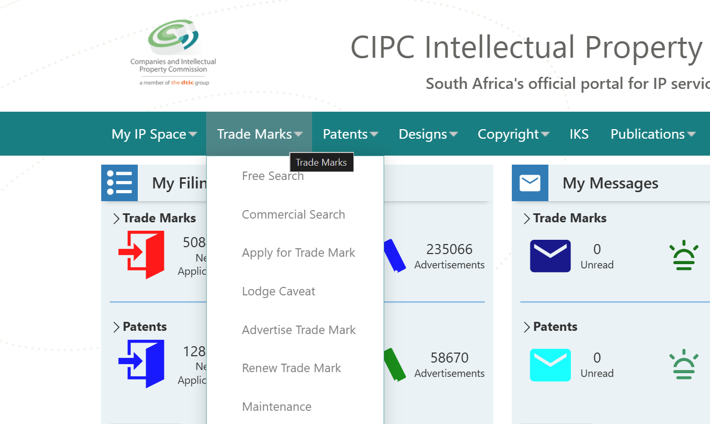
CURRENT LEVEL OF AUTOMATION: IP ONLINE

Slide 6
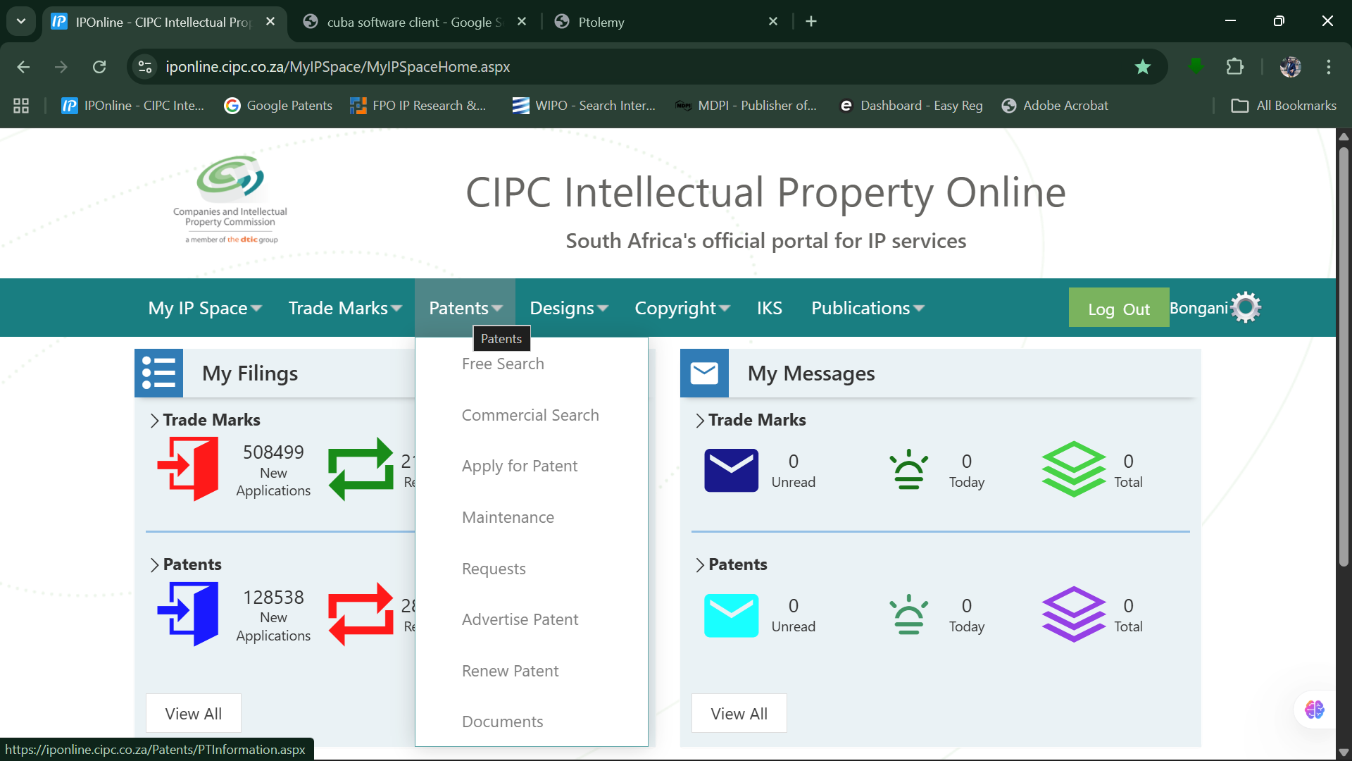
CURRENT LEVEL OF AUTOMATION: IP ONLINE

Slide 7
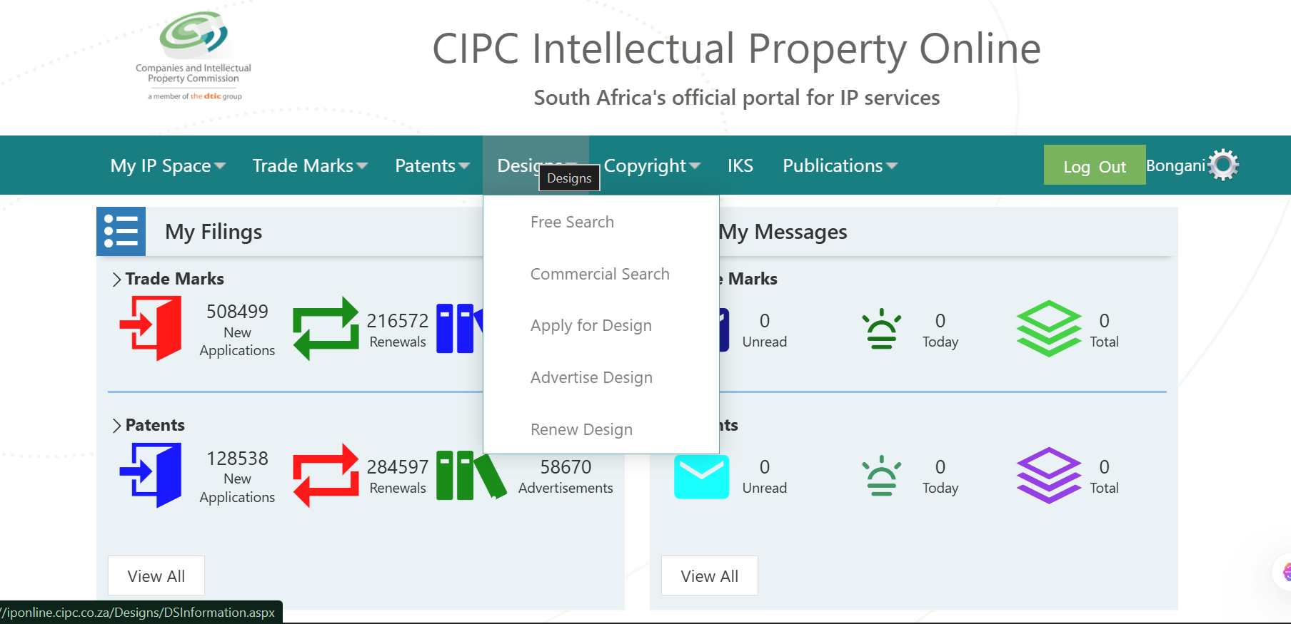
CURRENT LEVEL OF AUTOMATION: IP ONLINE

Slide 8
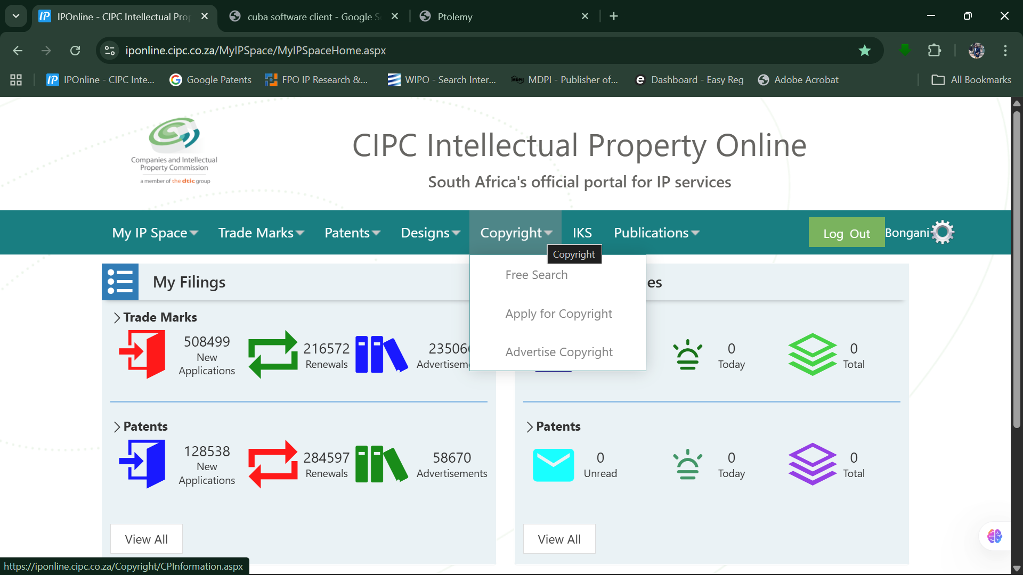
CURRENT LEVEL OF AUTOMATION: IP ONLINE

Slide 9
CURRENT LEVEL OF AUTOMATION: Ptolemy

Slide 10
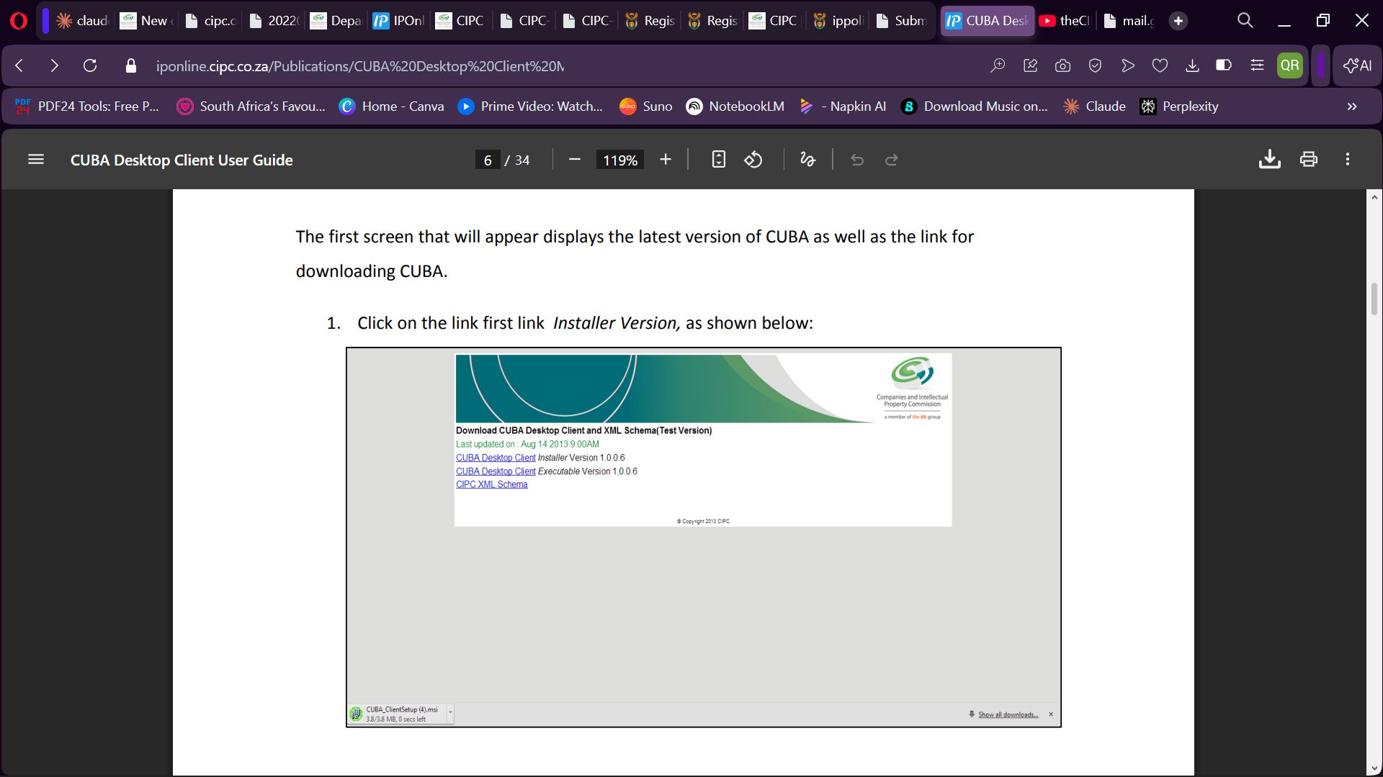
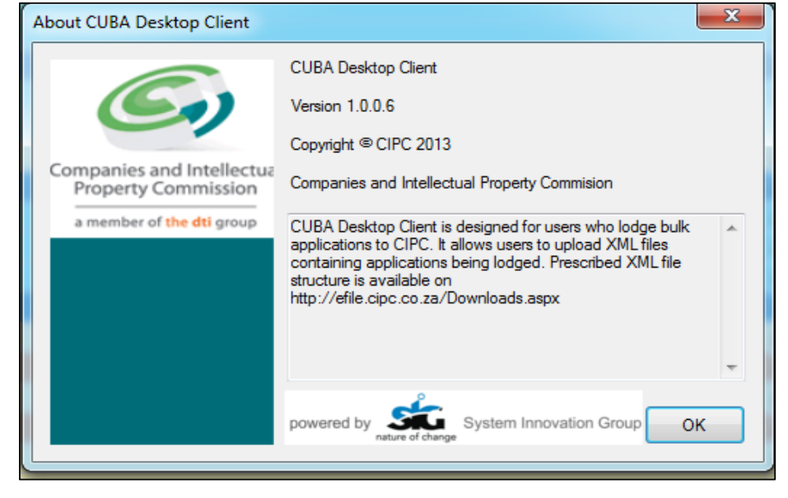
CURRENT LEVEL OF AUTOMATION: CUBA

